Slide 1


2026
Impact Booth Election
Toolkit

Slide 2

New Early Voting Process & Voter Education Impact Booth Toolkit
Everything a BPOU, church, club or volunteer needs to register, educate, and GET OUT THE VOTE in 2026!

Slide 3

First the New Early Voting Changes
47 days to Vote
Pick your date today!!!

Slide 4
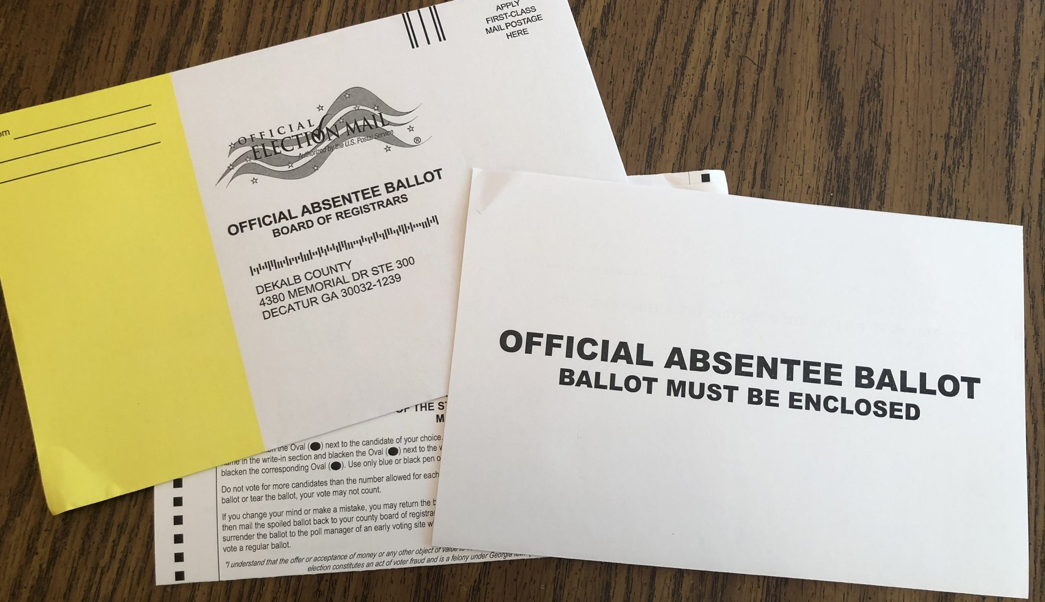
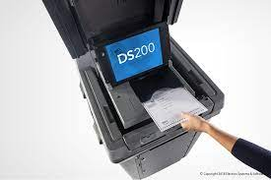
In-Person Absentee Voting New Process
1. Absentee Voting by Envelope in-person – at City Hall or County Voting Location. They will help you fill it out and witness it right there.
46 days to 19 day before Election Day
2. Absentee Voting in-person by Tabulator – at City Hall or County Voting Location. It takes 5 min.
18 day before Election Day
Absentee Ballots can be submitted up to 8:00 PM on Election Day at County Voting Locations.

Slide 5
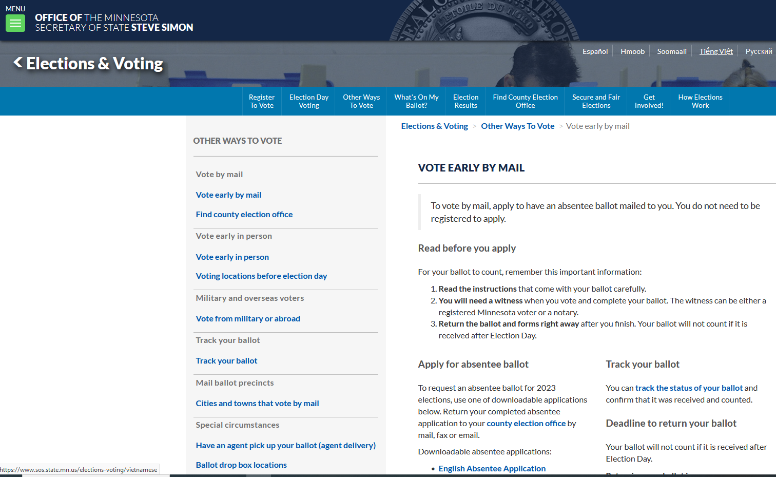
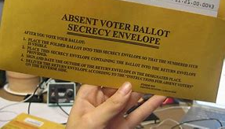
Absentee Request (Digital)
3. Absentee Voting by envelope – MNVOTES.org
https://www.sos.state.mn.us/elections-voting/other-ways-to-vote/vote-early-by-mail/
Process:
Fill out Digital form
Ballot received in the mail
Fill out ballot
(a) Return by mail
(b) Return to County voting location by
8 PM election day.

Slide 6
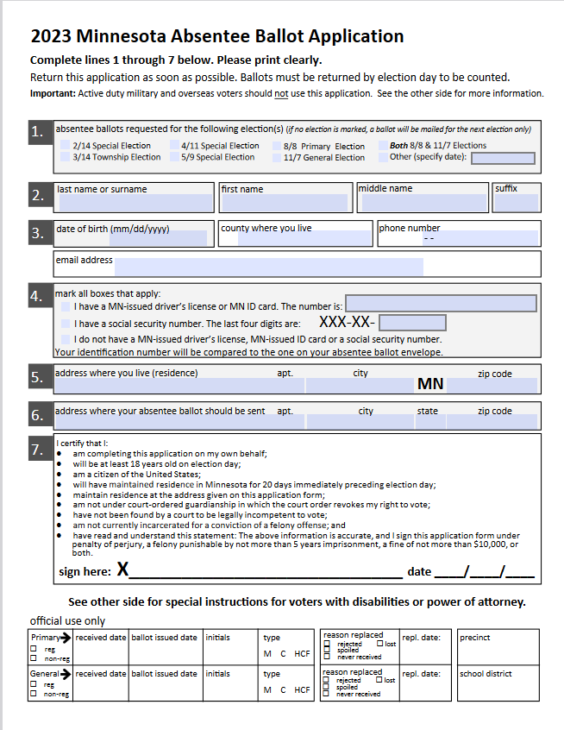
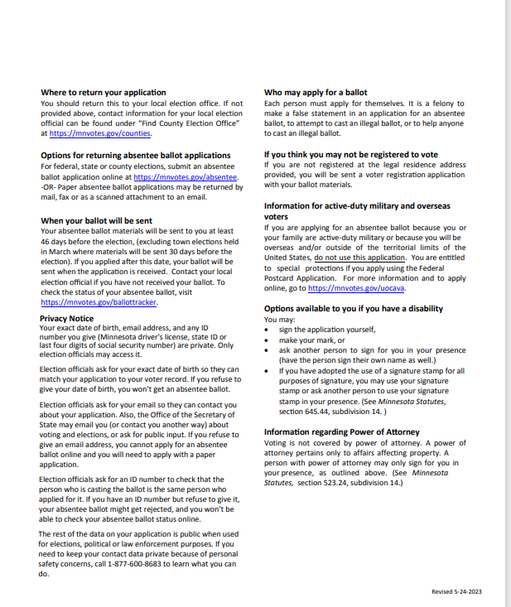
Digital form to fill out and submit online to be mailed an Absentee Ballot: :

Slide 7

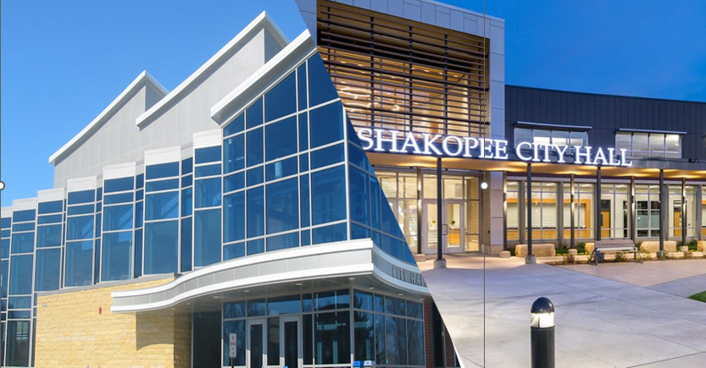
Where to bring your Absentee Ballot -
Where you got it , is where you submit it.
Pick it up at the City Hall – submit
back to City Hall
Request a ballot from MNVOTES.org – bring or mail to County voting location
You have until 8 PM on Election Day to submit your ballot regardless of when you received it or picked it up.

Slide 8
Election Timetable
All In- Person Voting
 | Absentee by Envelope |  | 1st Day Absentee by Tabulator | Election Day
Primary
47 | June 26 |  | July 24 | Aug 11, 2026
General
47 | Sept. 18 |  | Oct. 16 | Nov. 3, 2026
Days to Vote

Slide 9
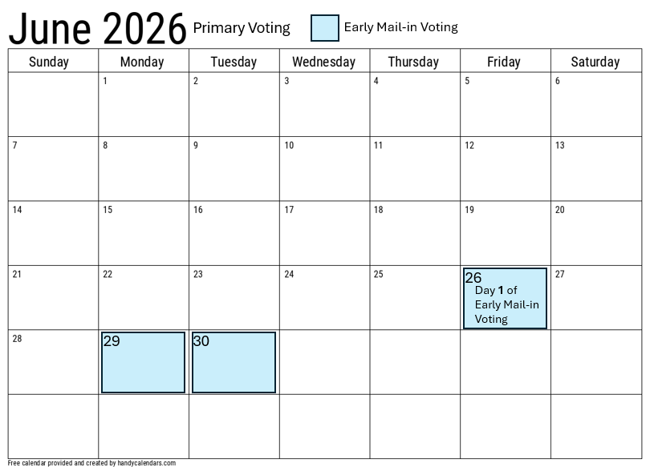
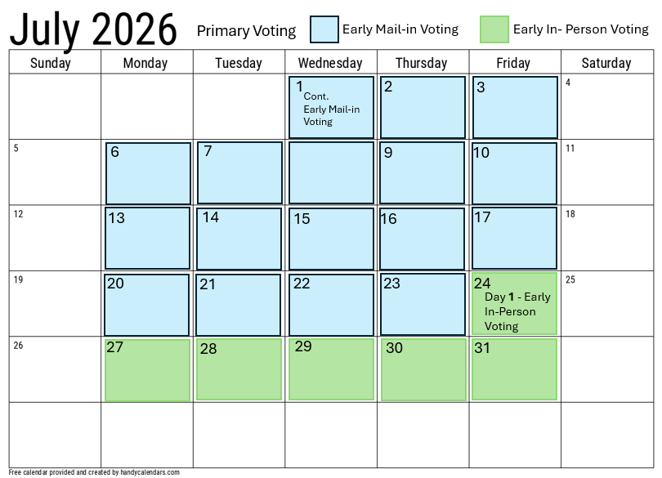
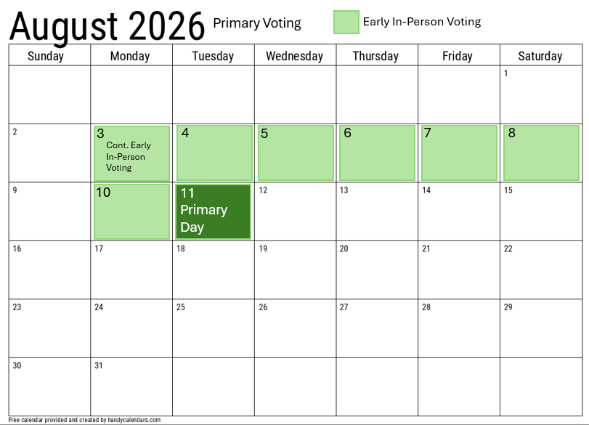
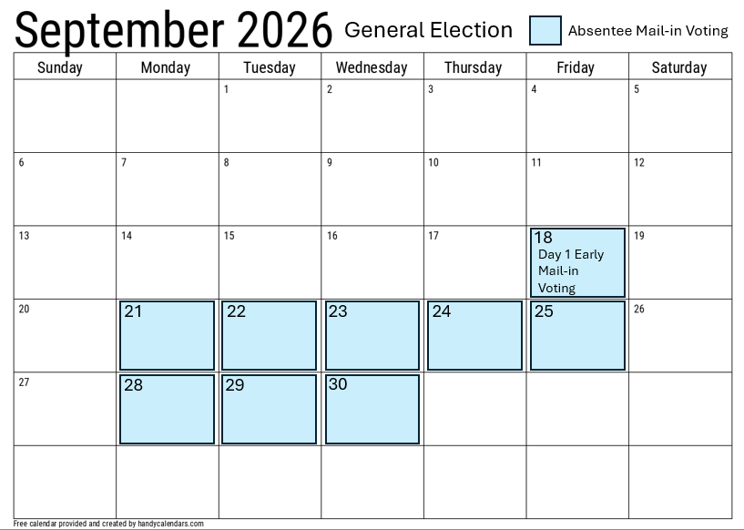
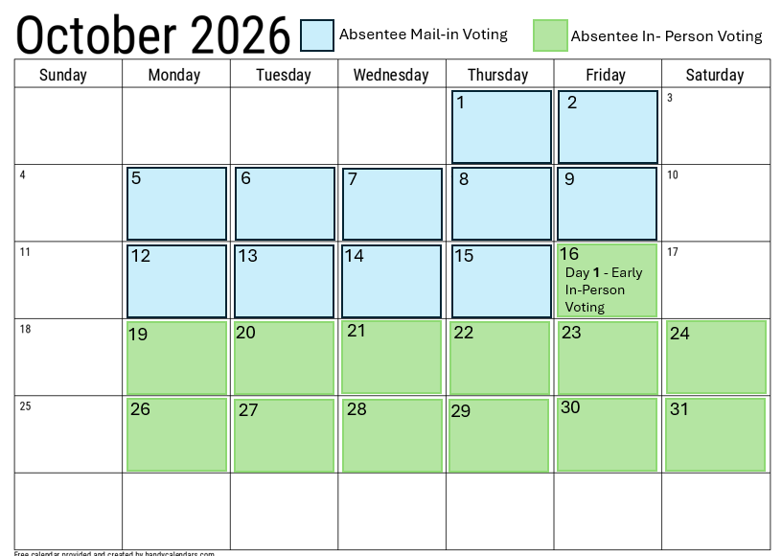
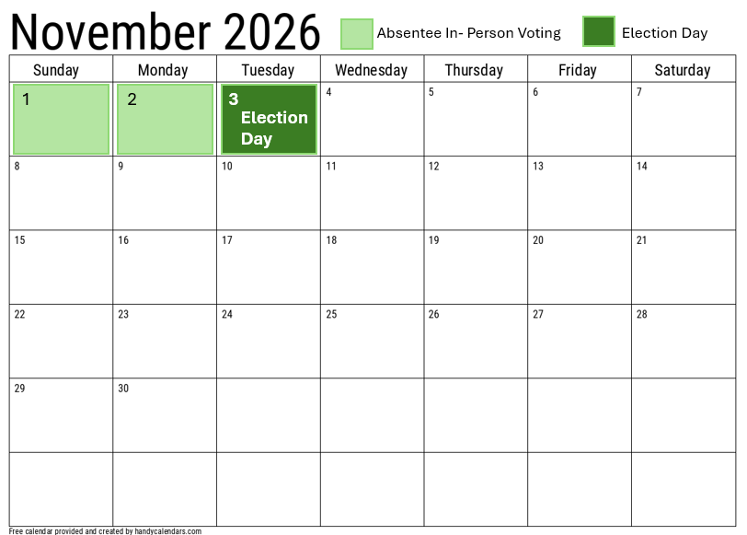
2026 Primary Election Calendar:
Absentee Envelope Voting June 26 – July 23; Absentee in-person July 24 – Aug. 11
2026 General Election Calendar:
Absentee Envelope Voting Sep. 18 – Oct. 15; Absentee in-person Oct. 16 – Nov. 3rd

Slide 10

What happens to my Absentee Ballot?
In-Person Envelope
Envelope – mail or hand
In-Person By Tabulator
Envelopes are “banked” in a secure location and opened on Last day of AB by Envelope voting. They are then opened to compare envelope signature to ballot signature.
Number of ballots counted and then fed into tabulator.
8:00 PM Election Day all AB votes are tabulated.
Ballot board is convened to open envelopes and compare signatures weekly.
They are secured until 18 days before election day when they are fed into tabulator.
8:00 PM Election Day votes are tabulated.
Stored in secure tabulator until full, they are then banked in a secure location until Election night at 8:00 PM, when they are put through the tabulators to be vote counted.

Slide 11
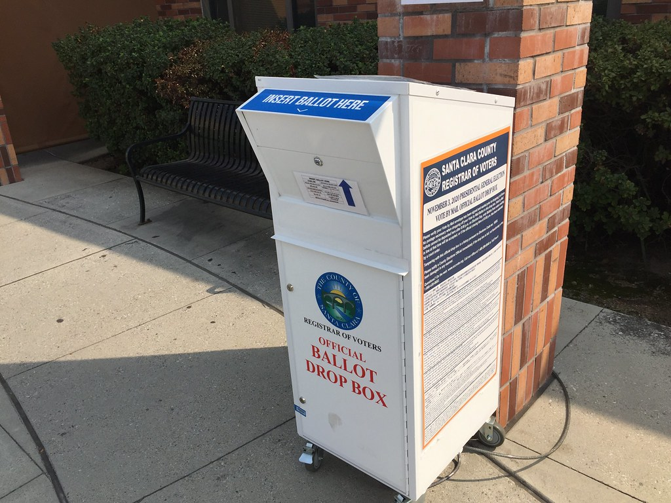
What about Drop Boxes?
Scott County
Hennepin County
Dakota County?
No Drop boxes
Drop locations manned by election judges at City Hall or the County voting location.
Each County voting location will have a monitored drop box as well.
No Drop boxes
Drop locations manned by election judges at City Hall or the County voting location.
Each County voting location will have a monitored drop box as well.
At this time they have not gotten direction from the county.

Slide 12

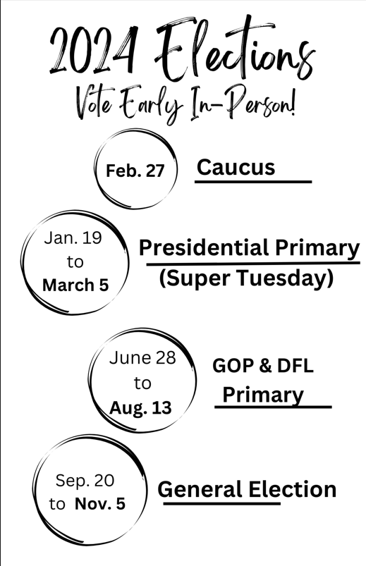
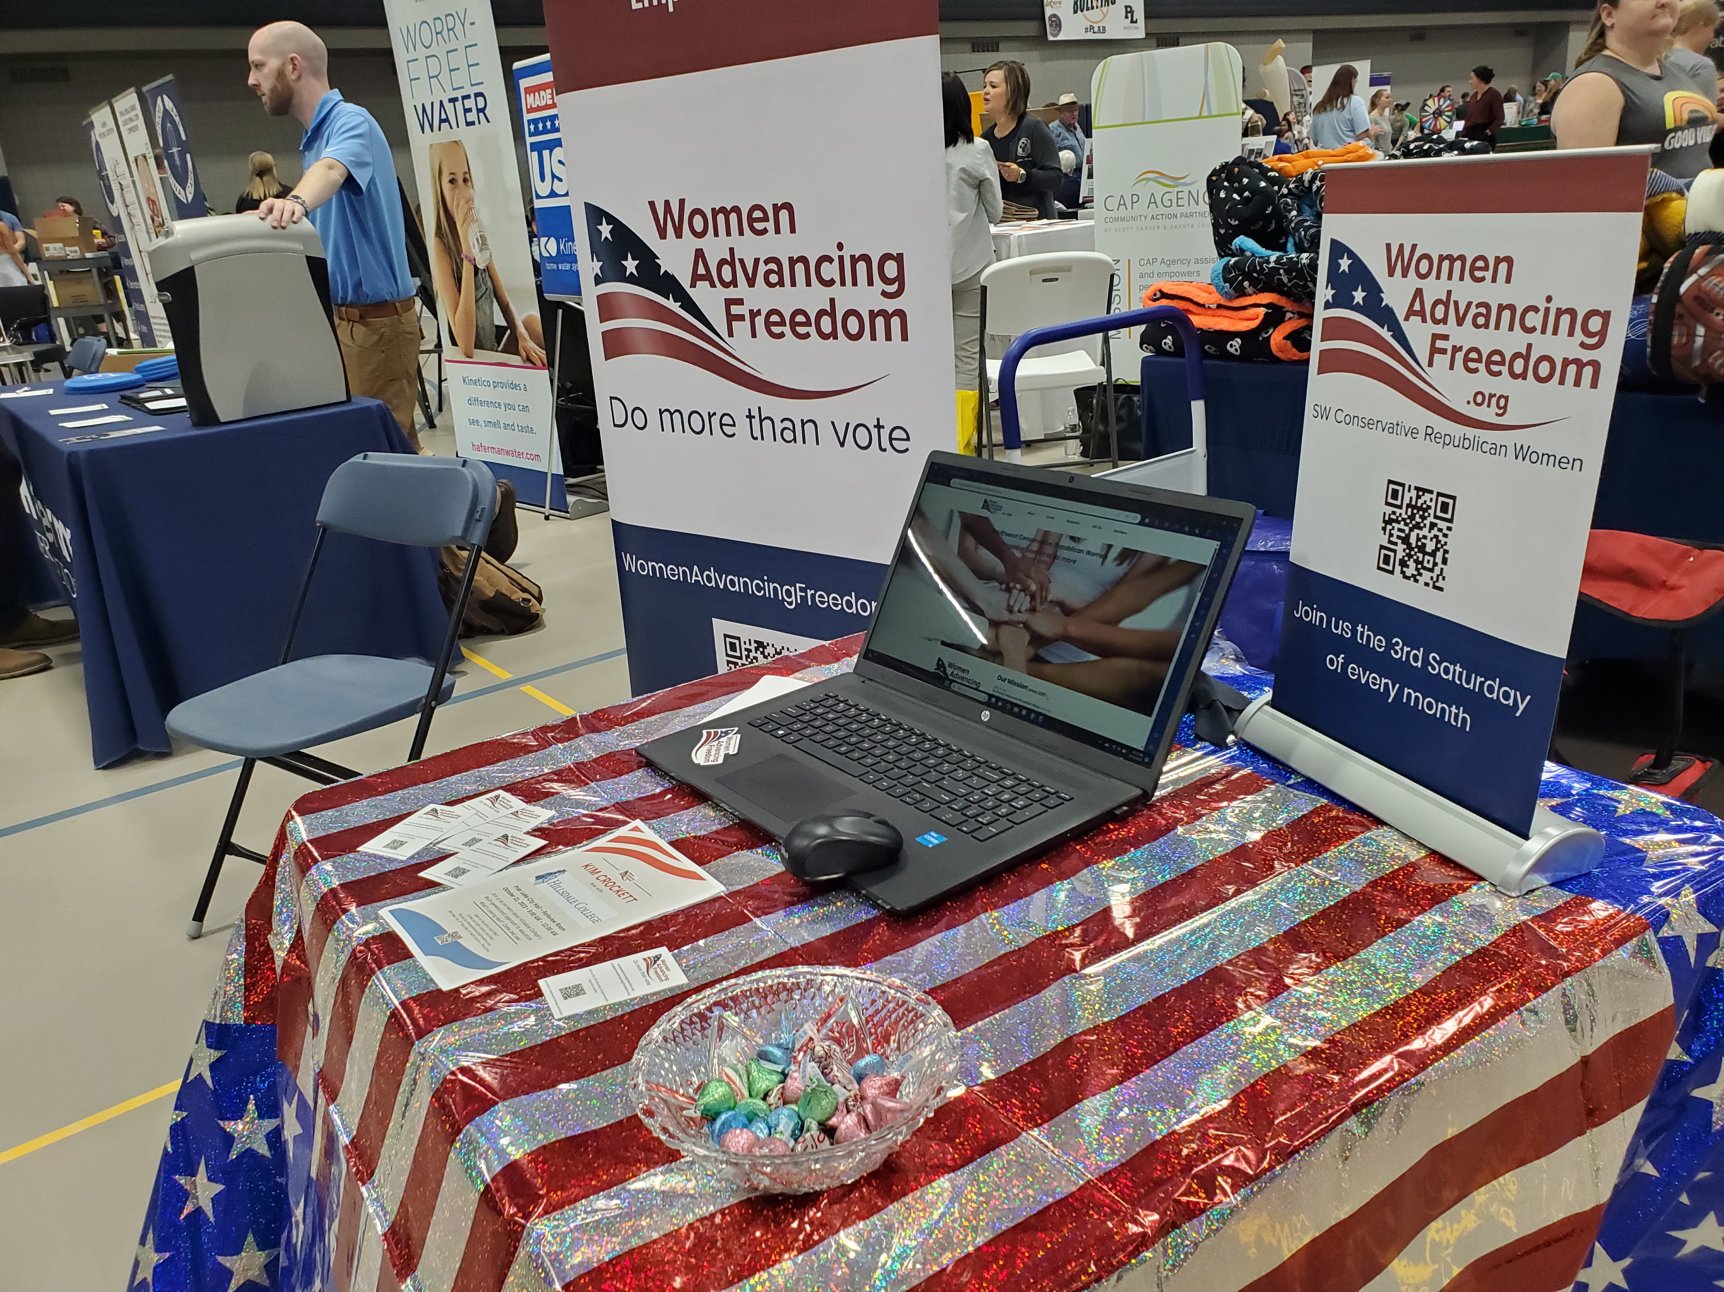
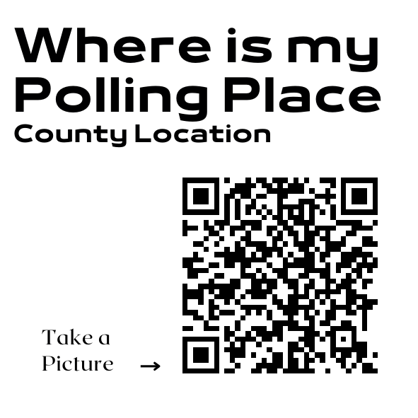
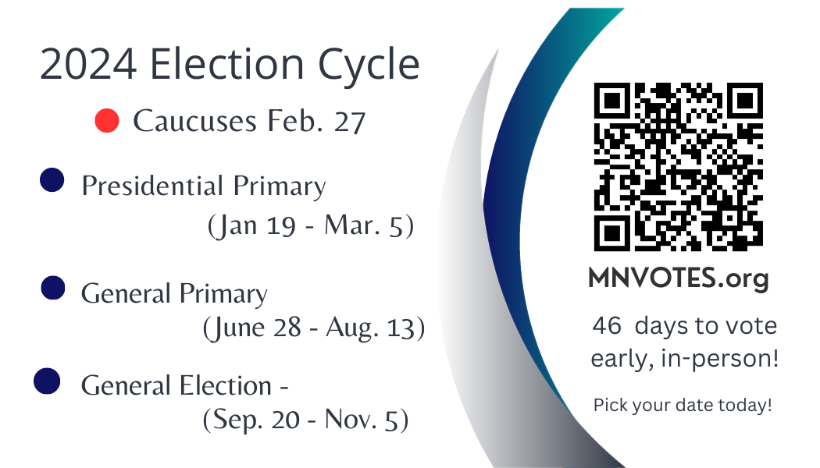
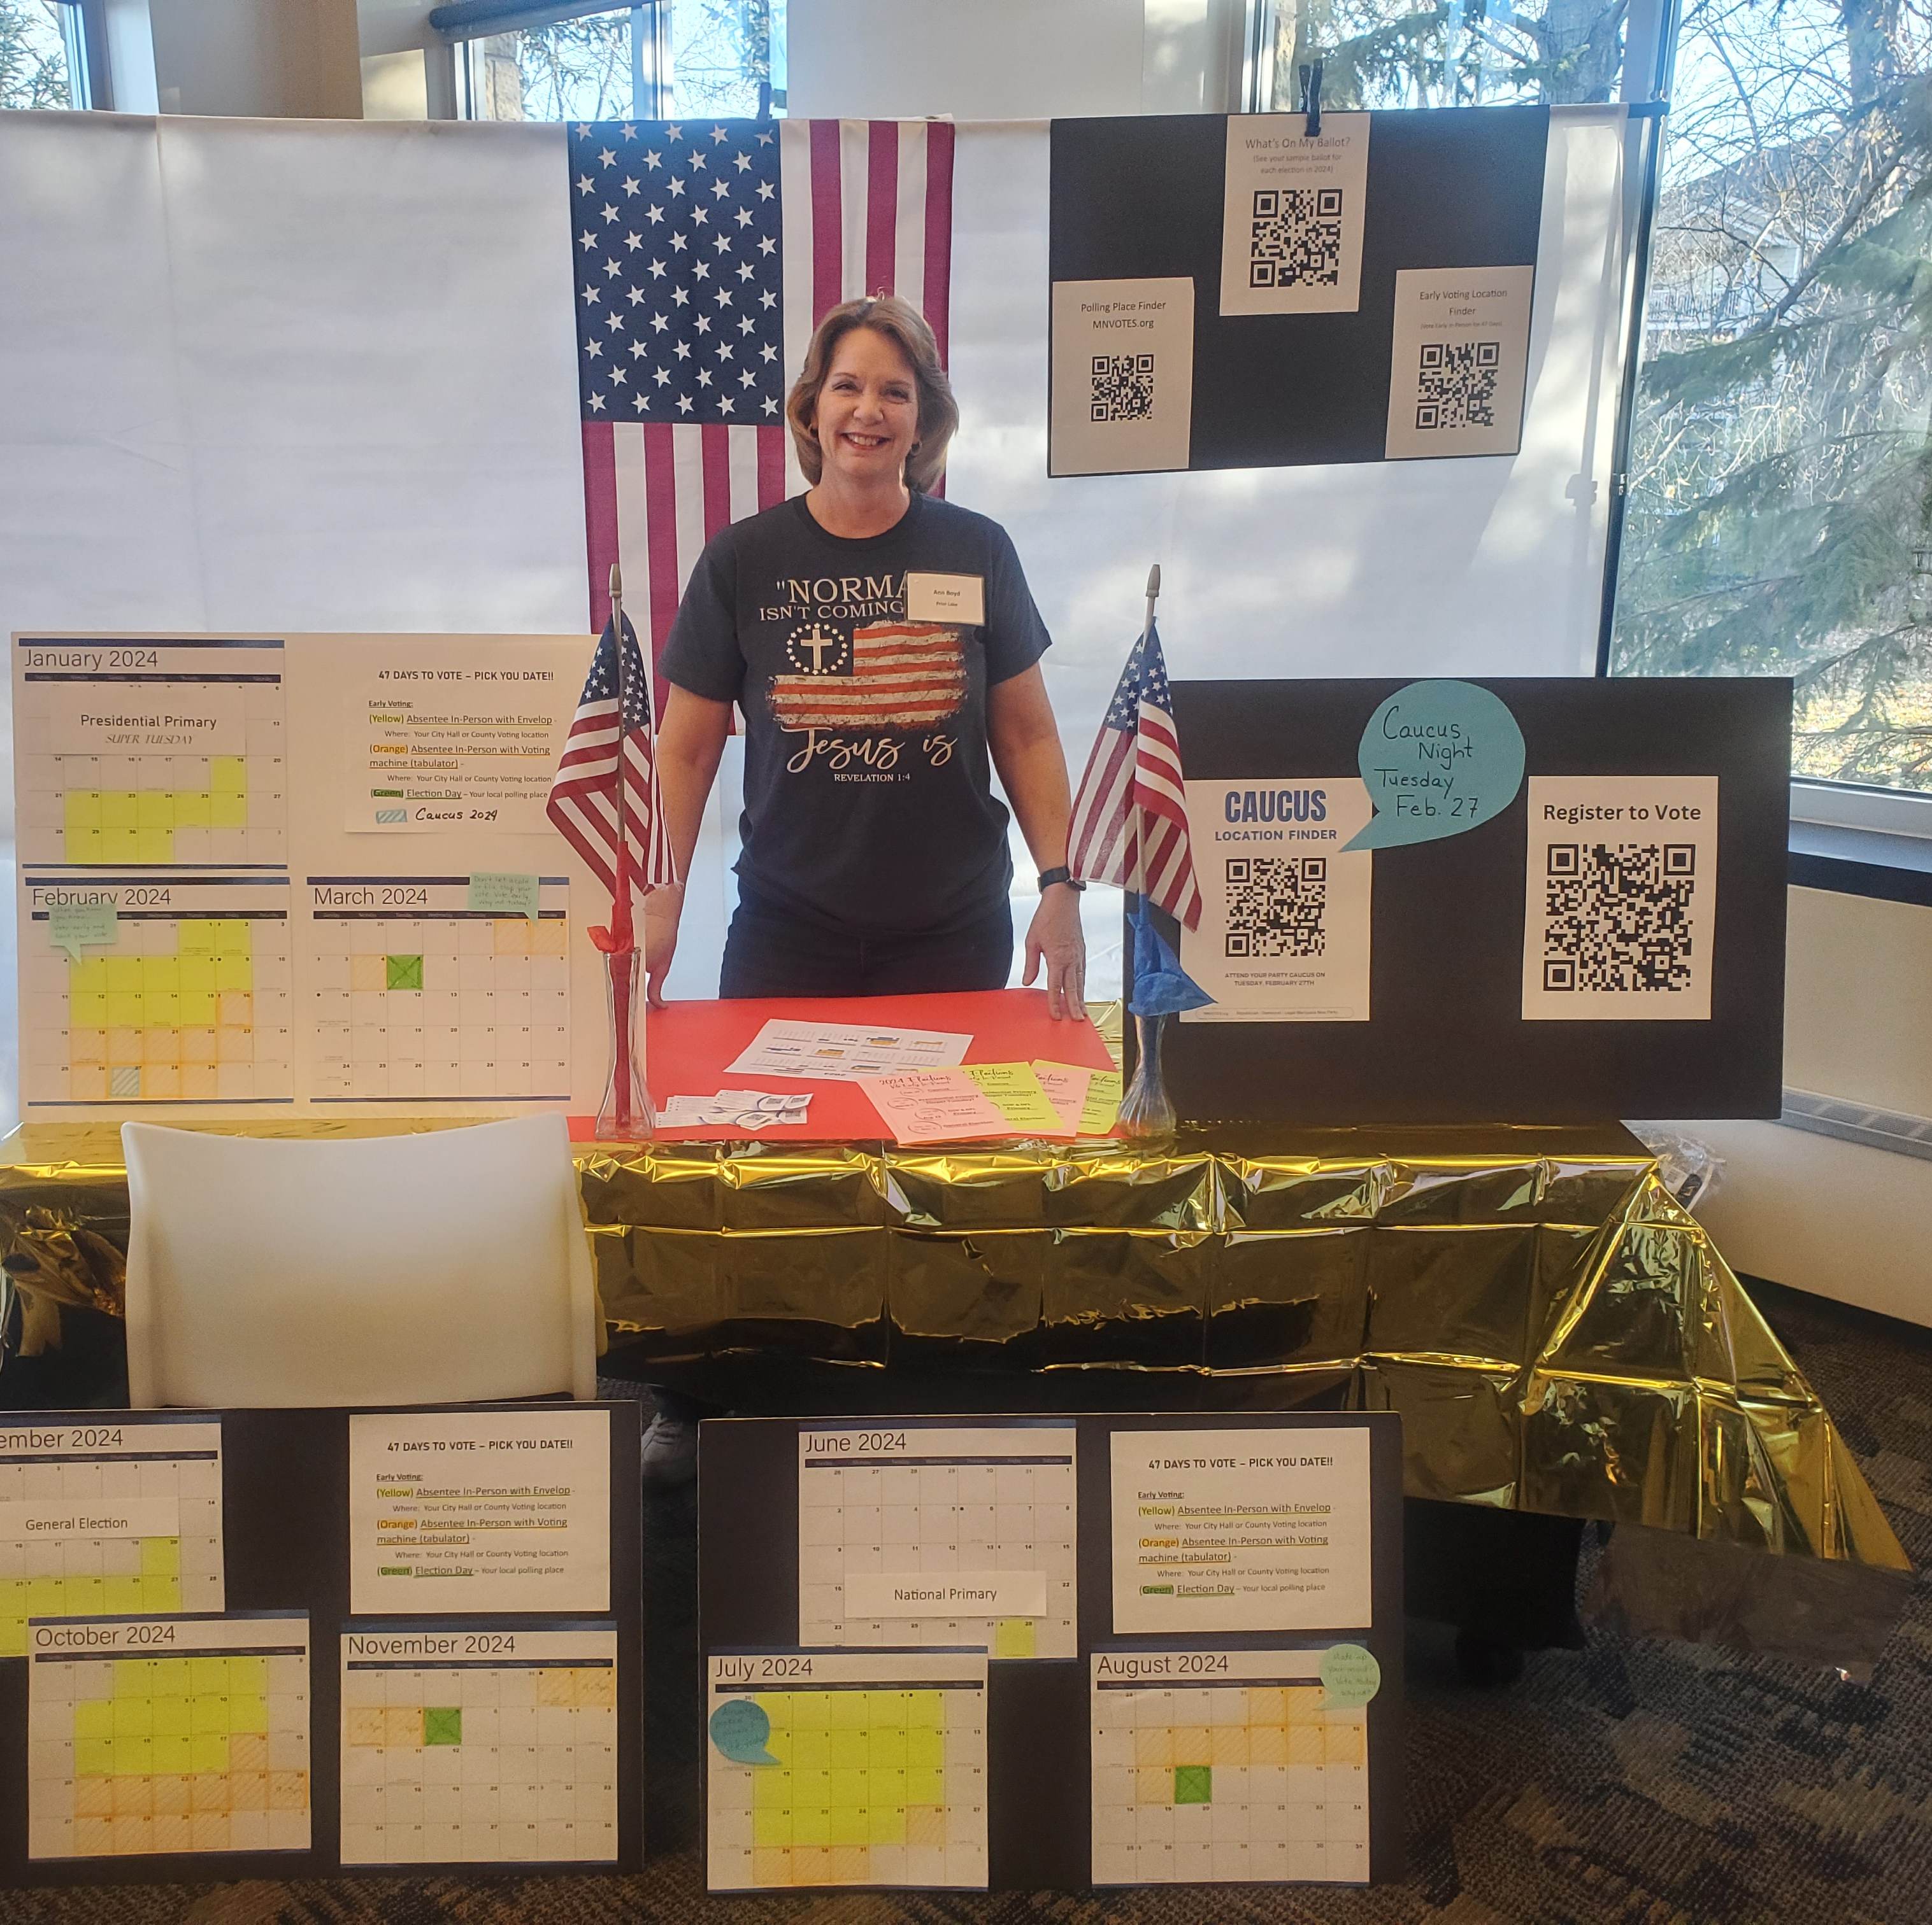
Part 2 – Toolkit for Voter Education
Who & Where
What You Should Include
Resources & Printables

Slide 13
Voter Education Display:
Targeted Locations
Non- Partisan & Ready
Conservative Church
Community Expo or Fair.
Farmer’s Market
Gun Shows
Homeschool Community
Christian Schools
High school graduation events
To be accepted at a church or other public event the goal is to present as non-partisan
Friendly
Welcoming
Informed about the process, willing to use resources to find information.
Tech savvy and paper savvy.
13

Slide 14

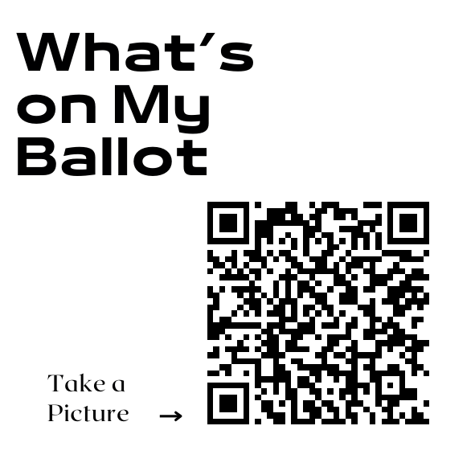
What to include:
QR codes
Decor
Resources
MNVOTES. org
What’s on my Ballot
Where is my Polling Place
Absentee Ballot Request
Register to Vote
Large QR displays
Table clothe that’s patriotic and eye catching
Banner – Voter info Here
Volunteers with smiles
Calendar display
WiFi access
Laptops
Cellphones
Tabs open to SOS sites
Paper list of County Voting Locations
Flyers
Business cards

Slide 15
Banner ideas:
47 days!!
Early Voting
New Voting Rules
New Voting Window
More Ways to Vote

Slide 16
Printables Provided:
QR codes on printable labeled page
  Caucus Finder
  Early Voting Locations
  MNVotes.org
  Polling place Finder
  What’s on my Ballot
  Polling place on Election day
  Register to Vote
47 Days to Vote page
Primary & General Election 2-sided flyers
2026 Election Cycle Calendars

Slide 17
Checklist:
What You’ll Need
Large Printed QR Codes
(on 8 x 11 + Foam Core board x 4, 2-sided tape)
    Register to vote
    What’s on my Ballot
    Election Day Voting Location
    Voting Locations – County
    Caucus Finder
Business cards with MNVOTES.org & Election dates 2024
(cardstock paper to print if needed)
Flyers with Election Calendar (colored paper)
Laptop (power cord and outlet, WiFi access or hotspot)
  SOS website tabs
  2024 Election Toolkit PowerPoint open
Printed list of County Locations
Calendar Display (Dollar store 2024 calendar & highlighters)
Banner or large Flag
Volunteers
LOCATION
Permission and dates
Table and chairs
Backdrop if possible (portable frame & drape)
Tablecloth

Slide 18
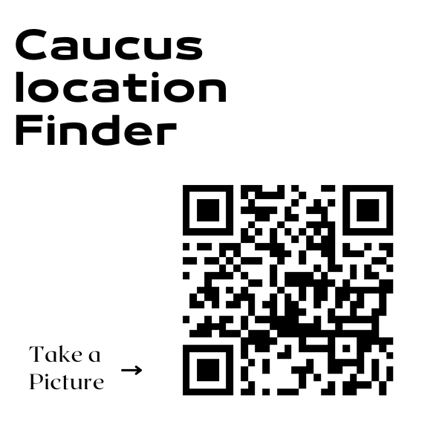
QR Codes
Generated free at
Canva or
Vistaprint
Samples of Printables:

Slide 19
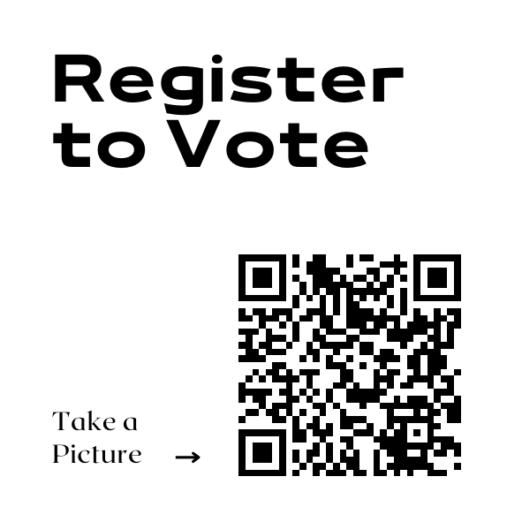
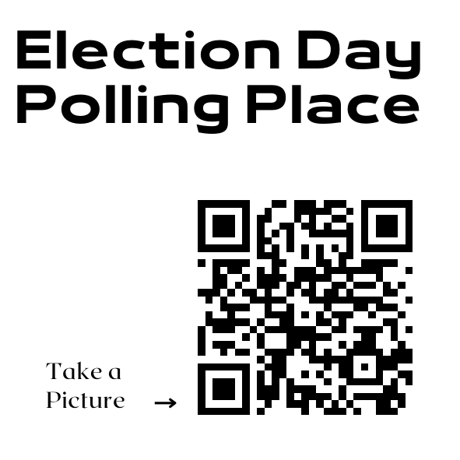

Slide 20
Business card calendars:

Slide 21

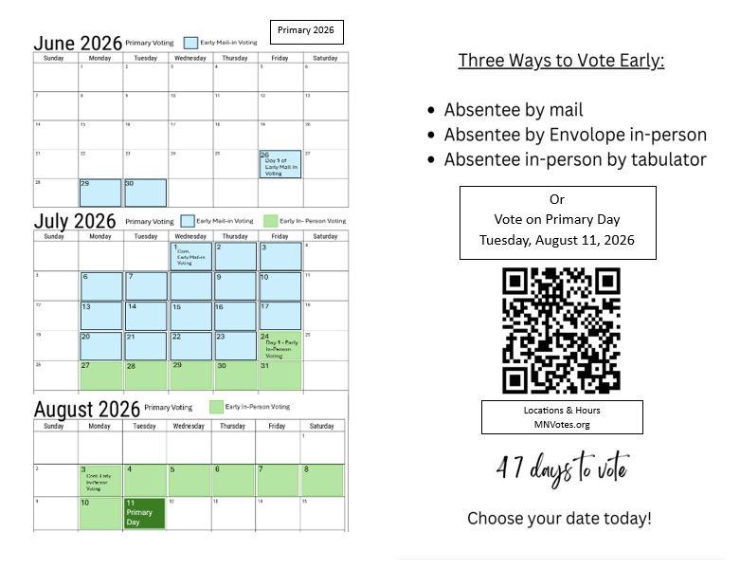
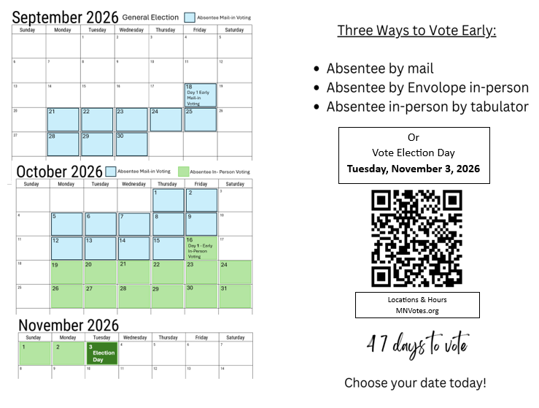
Tip: To save $money print on
pastel colored paper for
eye catching color without the
cost of custom copies.
(2 sided)

Slide 22
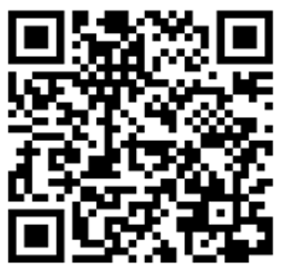
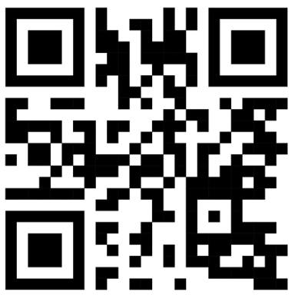
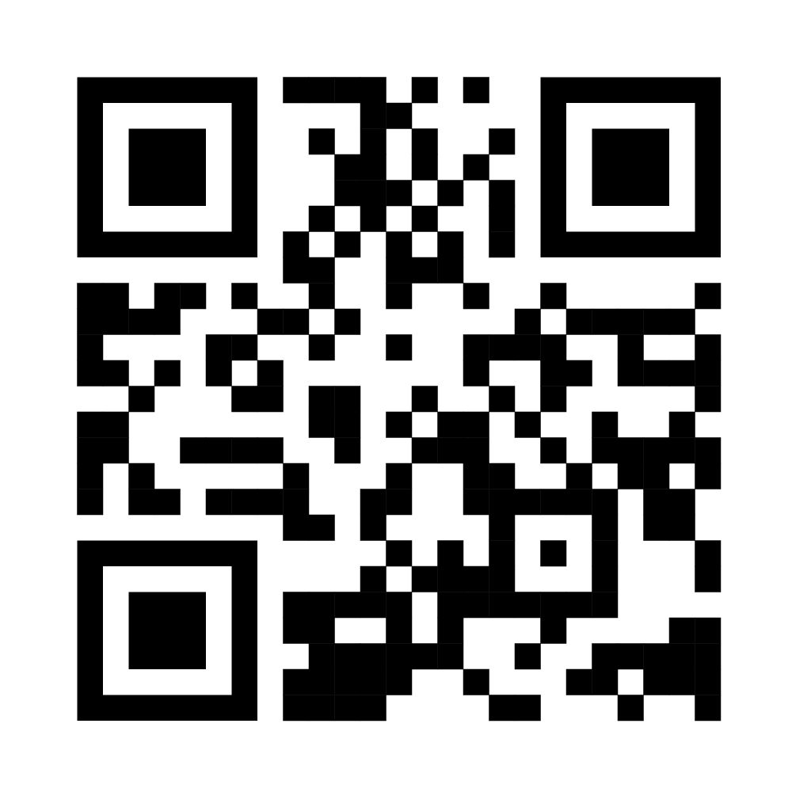
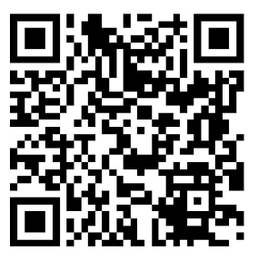
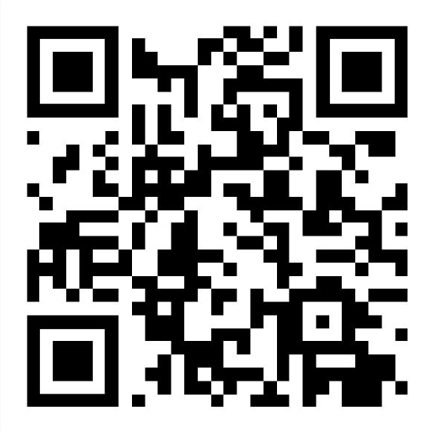
Voter Education “at a glance”
MNVotes.org
Secretary of State Website
Early Voting Locations
What’s on My Ballot
Secretary of State Website
Resource
30” x 20” foam core board
8” x 11” printed QR codes
(Tip: Be sure to separate QR codes
On the page.)
Register
Now!
Find Your
Polling Place

Slide 23
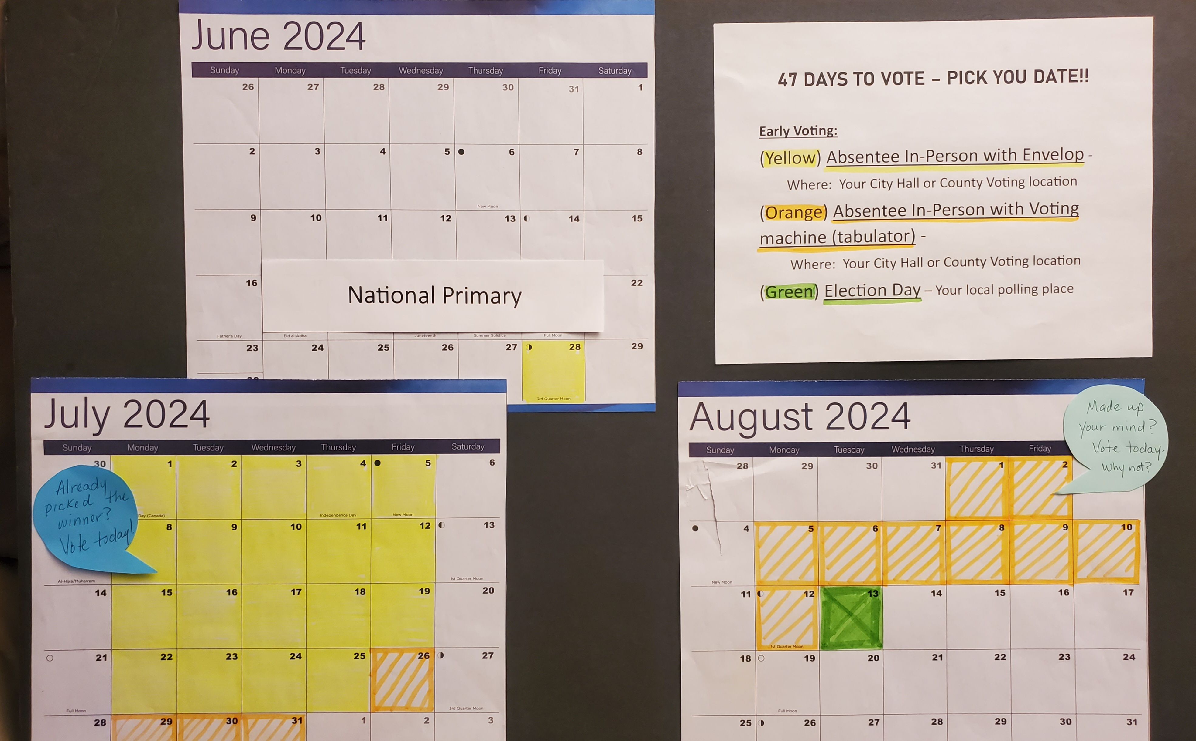
47 days
30 inch x 20 inch foam core board
Desk top calendars with highlighted voting days

Slide 24
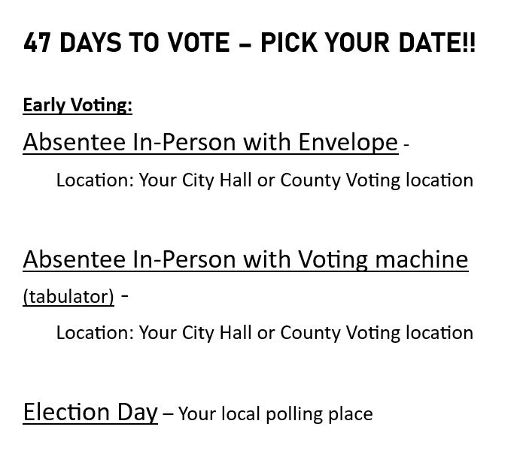
Clear Outline of the new Early voting system.
Tip: We never
Recommend
Mailing ballots

Slide 25

Thank you for your time: Brought to you by a Federation of Republican Women local club.
WomenAdvancingFreedom.org

