Slide 1
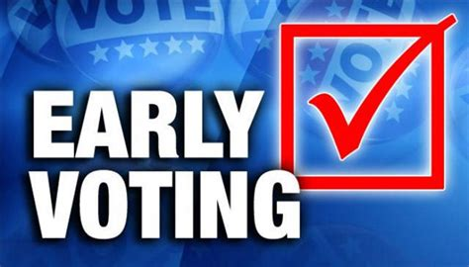
2024 Election Toolkit

Slide 2
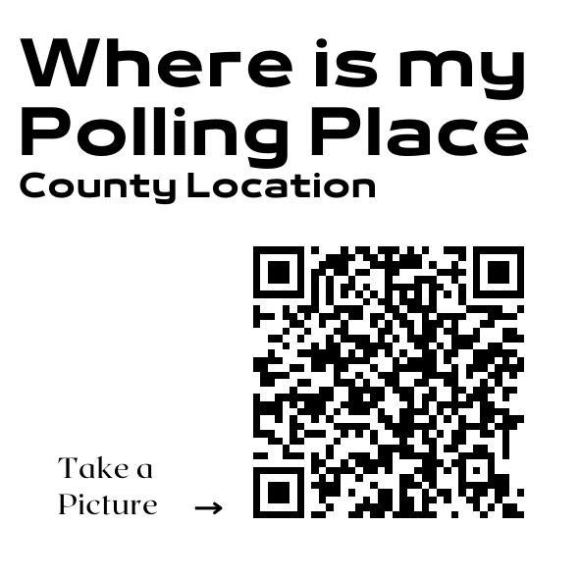
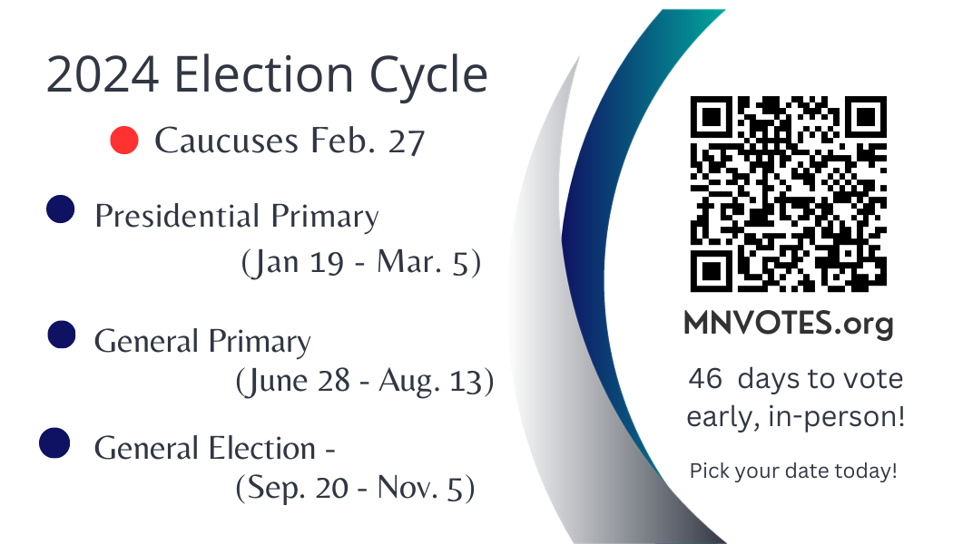
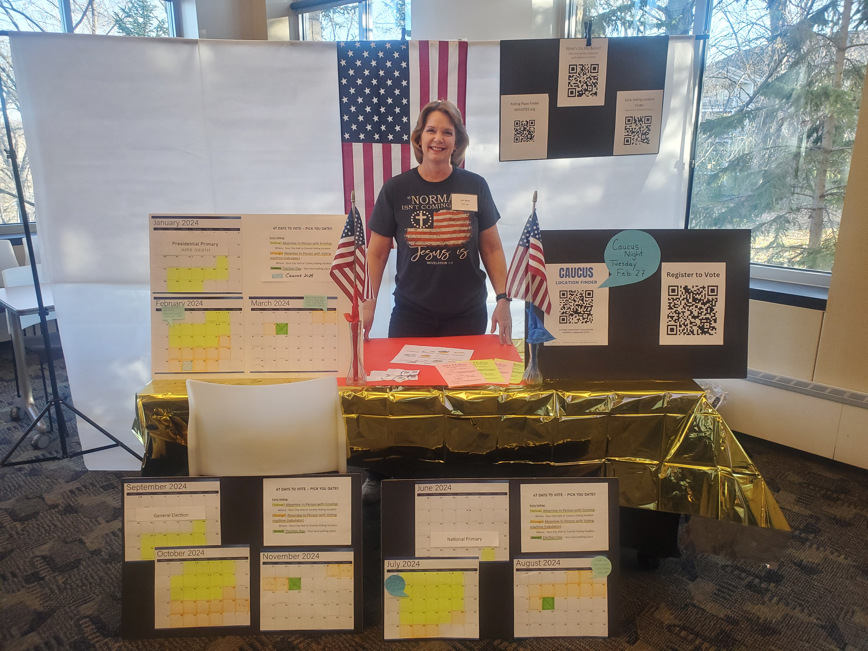
Toolkit for Voter Education
Who & Where
What You Should Include
Resources & Printables

Slide 3
Multiple opportunities to set up Early Voter Displays: One-time events or recurring displays through the cycle.
February 27th Precinct Caucuses
1
March 5
Presidential Primary
(Super Tuesday!)
Jan. 19 – Mar. 5
2
August 13
General Primary
June 28 – Aug. 13
3
November 5
General Election
Sep. 20 – Nov. 5
4
47 days
47 days
47 days

Slide 4
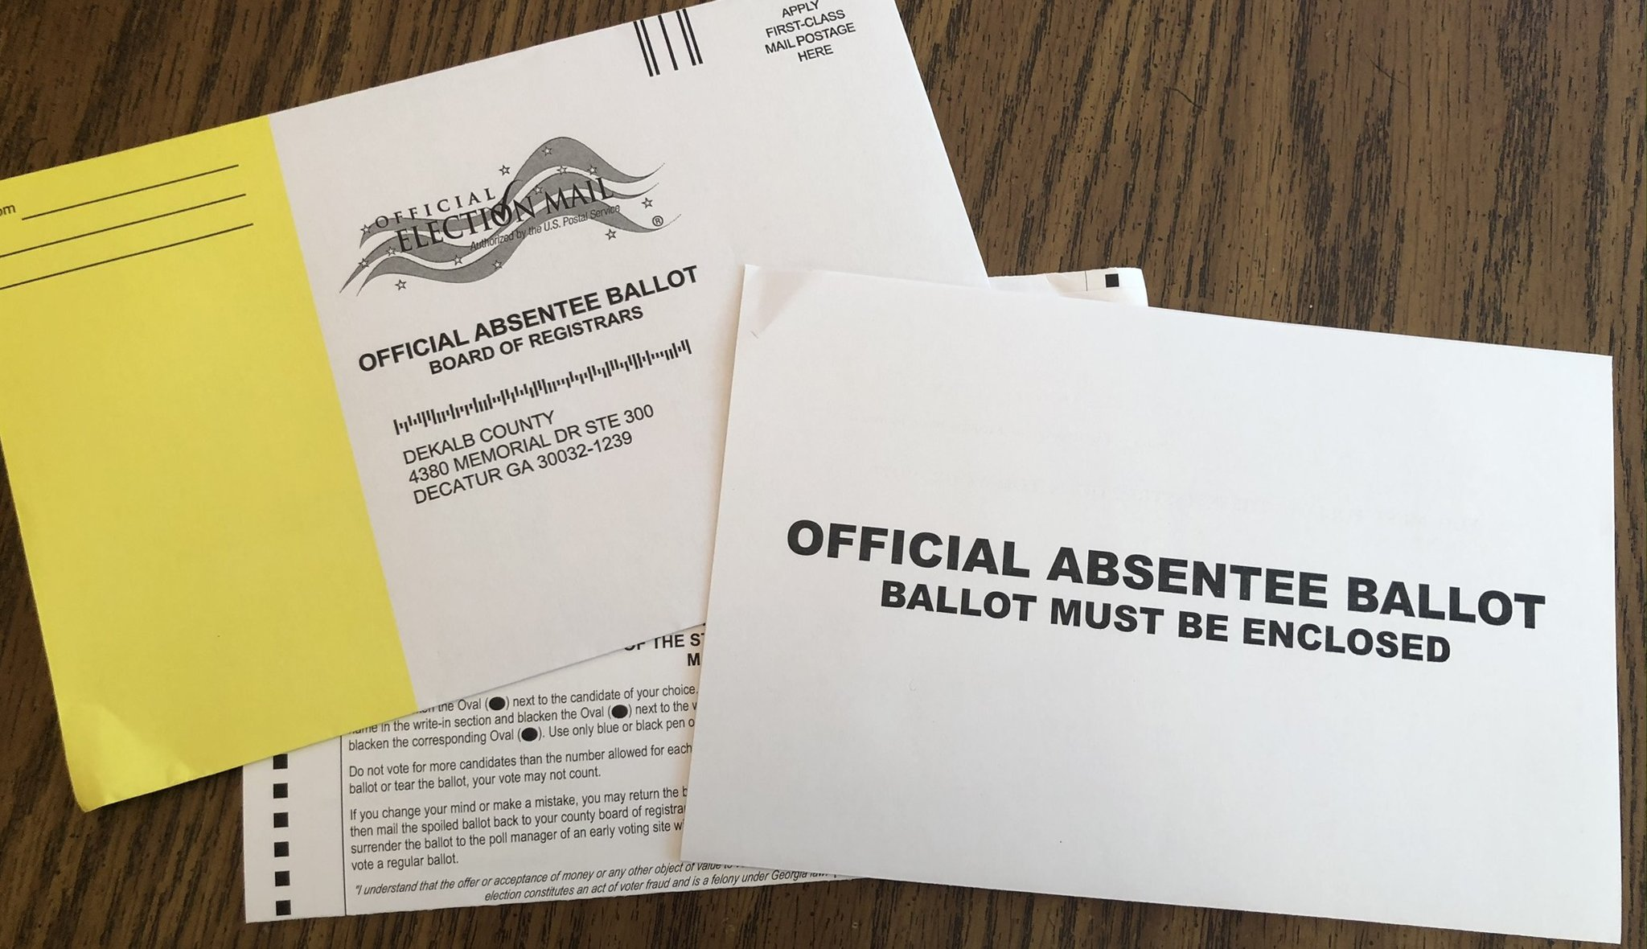
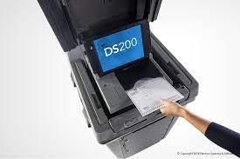
In-Person Absentee Voting New Process
Absentee Voting by Envelope in-person – at City Hall or County Voting Location. They will help you fill it out right there and witness it.
46 days to 19 day before Election Day
Absentee Voting in-person by Tabulator – at City Hall or County Voting Location. It takes 5 min.
18 day before Election Day
Absentee Ballots can be submitted up to 8:00 PM on Election Day at County Voting Locations.

Slide 5
Voter Education Display:
Targeted Locations
Non- Partisan & Ready
Conservative Church
Community Expo or Fair.
Farmer’s Market
Gun Shows
Homeschool Community
Christian Schools
High school graduation events
To be accepted at a church or other public event the goal is to present as non-partisan
Friendly
Welcoming
Informed about the process, willing to use resources to find information.
Tech savvy and paper savvy.
5

Slide 6
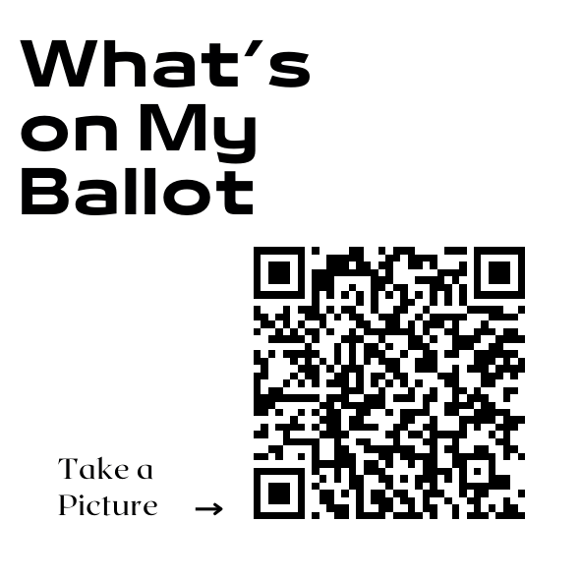
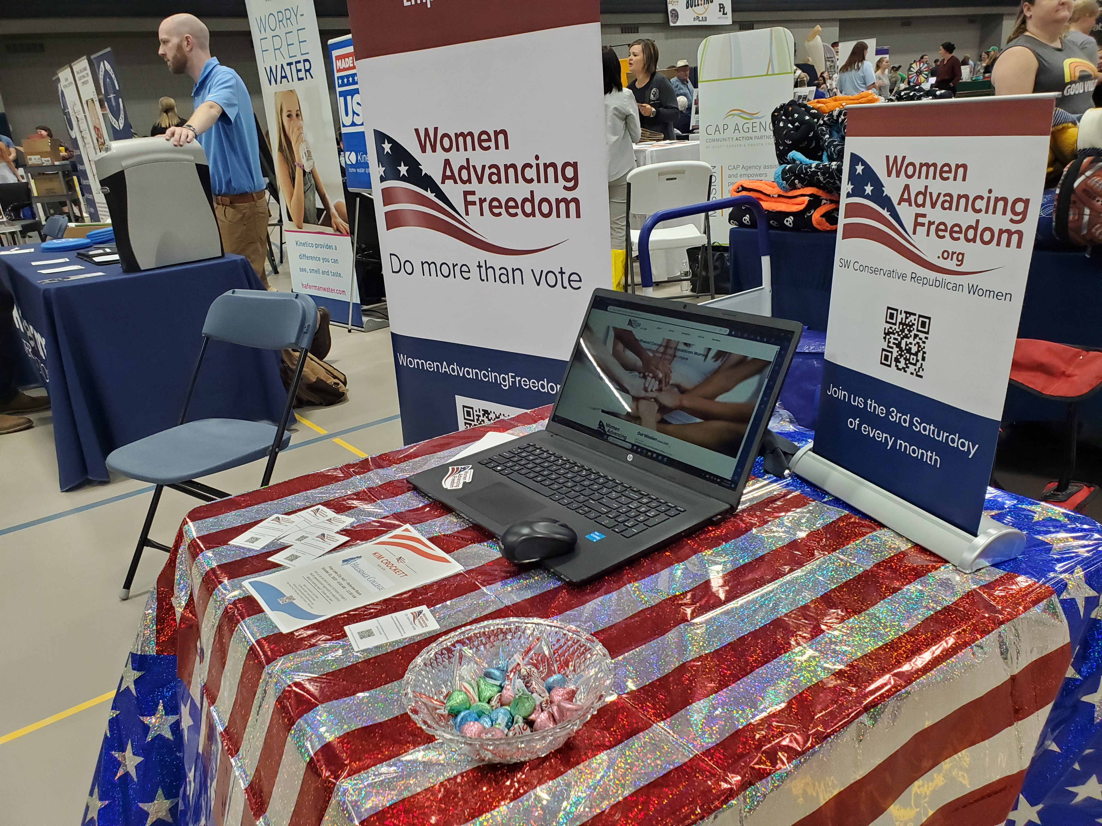
What to include:
QR codes
Decor
Resources
MNVOTES. org
What’s on my Ballot
Where is my Polling Place
Absentee Ballot Request
Register to Vote
Large QR displays
Table clothe that’s patriotic and eye catching
Banner – Voter info Here
Volunteers with smiles
Calendar display
WiFi access
Laptops
Cellphones
Tabs open to SOS sites
Paper list of County Voting Locations
Flyers
Business cards

Slide 7
Banner ideas:
47 days!!
Early Voting
New Voting Rules
New Voting Window
More Ways to Vote

Slide 8
Printables Provided:
QR codes on printable labeled page
Caucus Finder
Early Voting Locations
MNVotes.org
Polling place Finder
What’s on my Ballot
Polling place on Election day
Register to Vote
Election Titles to clip
47 Days to Vote key
2-sided flyer
Business card template to print

Slide 9
Checklist: What You’ll Need
LOCATION
Permission and dates
Table and chairs
Backdrop if possible (portable frame & drape)
Tablecloth
Large Printed QR Codes on 8 x 11 (Foam Core board x 2, Dollar store)
Register to vote
What’s on my Ballot
Election Day Voting Location
Voting Locations – Early and Election Day
MNVOTES.org
Caucus Finder
Business cards with MNVOTES.org & Election dates 2024 (cardstock paper)
Flyers with Election Calendar (colored paper)
Laptop (power cord and outlet, WiFi access or hotspot)
SOS website tabs
2024 Election Toolkit PowerPoint open
Printed list of County Locations
Calendar Display (Dollar store 2024 calendar & highlighters, Foam Core x 3)
Banner or large Flag
2-sided tape is a must!
Volunteers

Slide 10
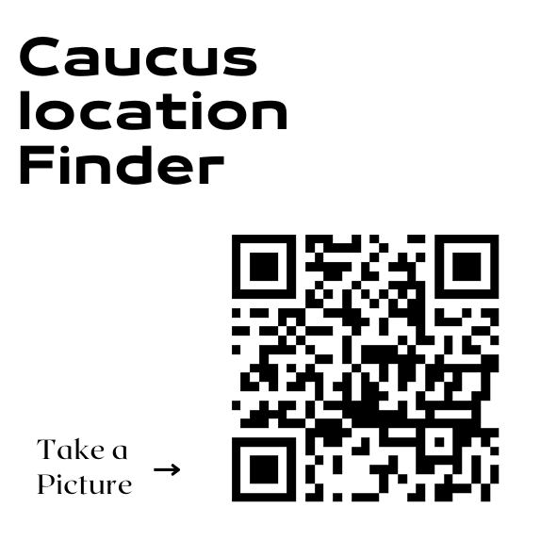
What we have for you to use: Tip: QR Codes Generated free at Canva or Vistaprint
Samples of Printables:

Slide 11
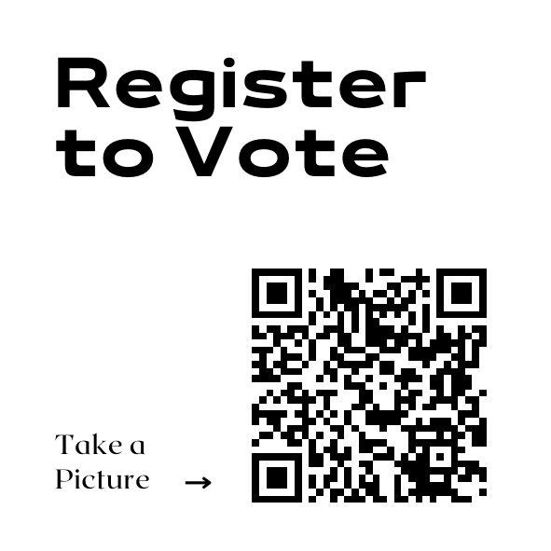
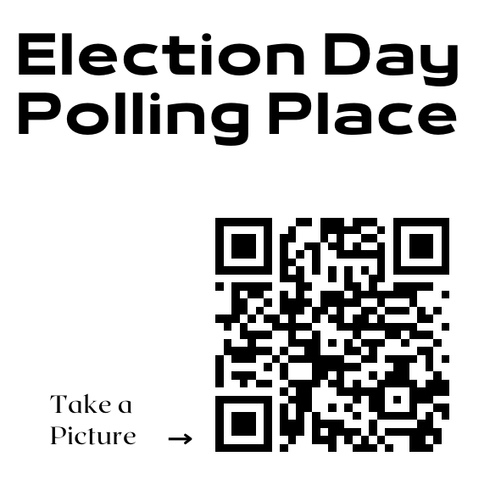

Slide 12
Business card calendars: Tip: Use a Word template to print by the page. Designed on Canva.

Slide 13
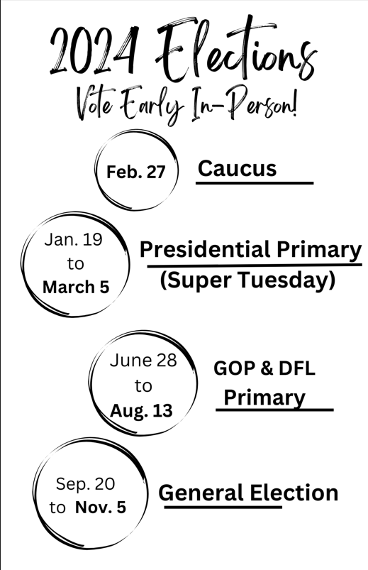
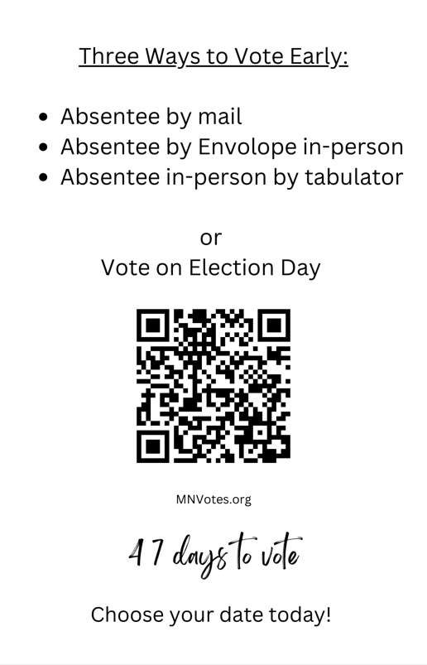
Tip: To save $money print
on pastel colored paper for
eye catching color without
The cost of custom copies.
(2-sided, half sheets)

Slide 14
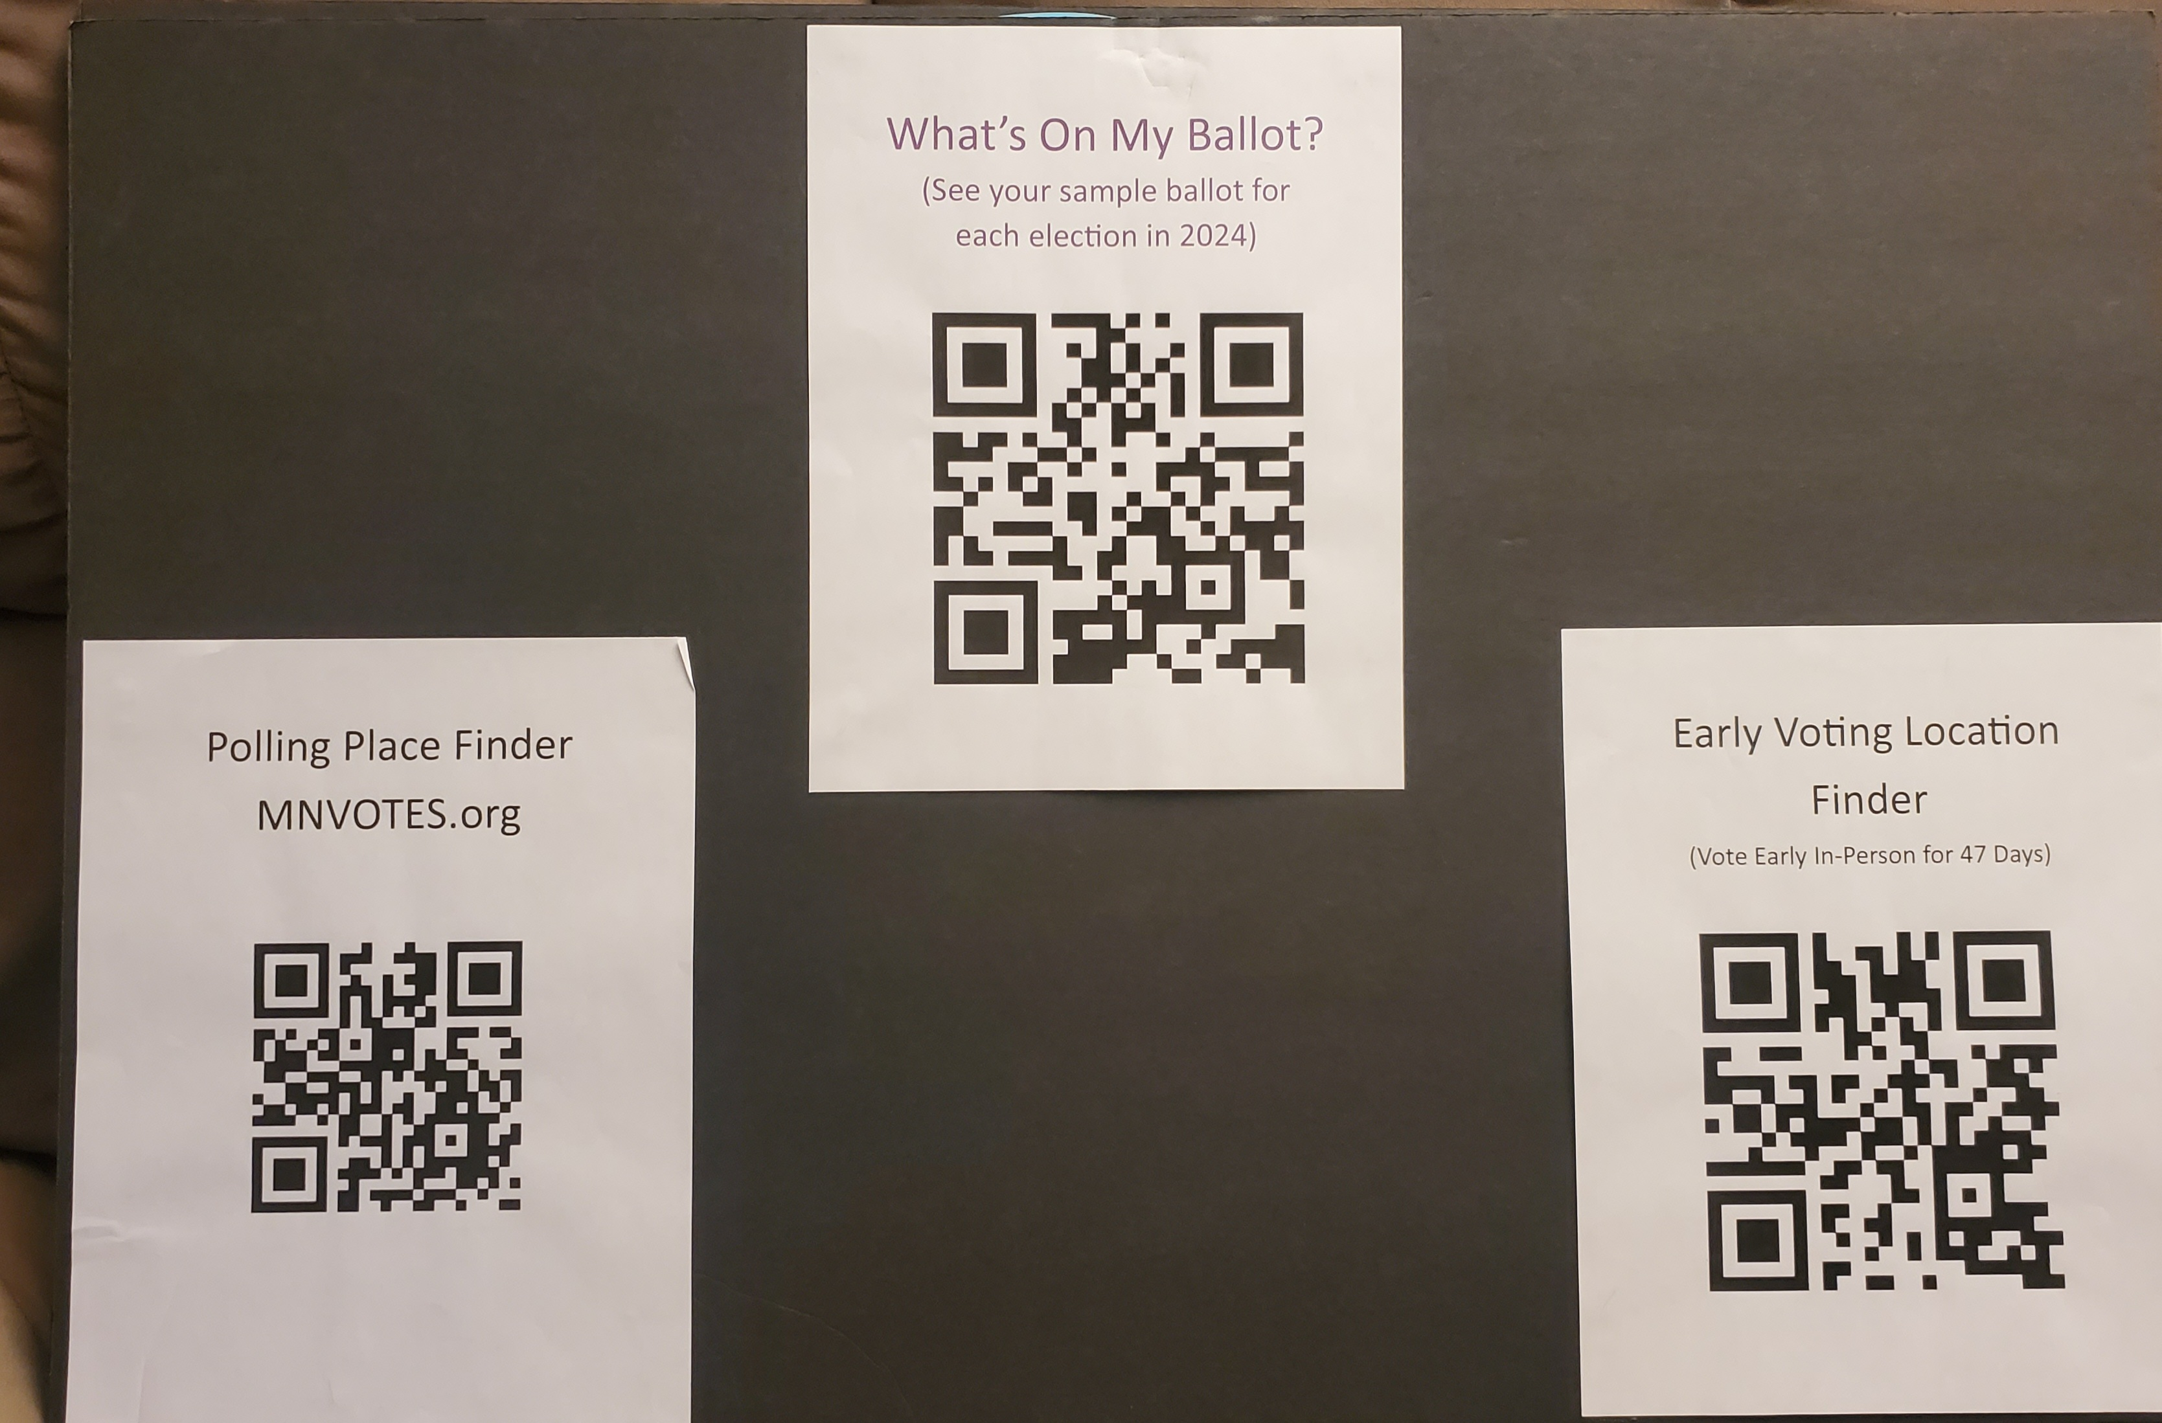
Voter Education at a glance
30 inch x 20 inch foam core board
8” x 11” printed QR codes

Slide 15
47 days
30 inch x 20 inch foam core board
Desk top calendars with highlighted voting days

Slide 16
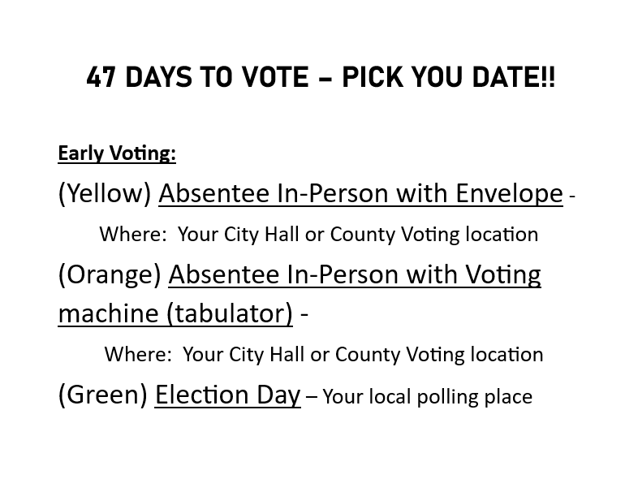
Clear Outline of the new Early voting system.

Slide 17
Republican Caucus Timeline – Possible recruitments and training for Early voter displays?
February 27th Precinct Caucuses
1
?
BPOU Convention
2
April 27
CD2 Convention
3
May 17/18
State Convention
4

Slide 18
Thank you for your time: Brought to you by a Federation of Republican Women local club.
WomenAdvancingFreedom.org

