Slide 1
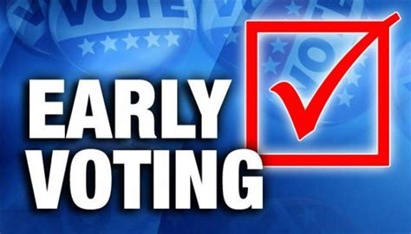

2026
Election
Toolkit

Slide 2

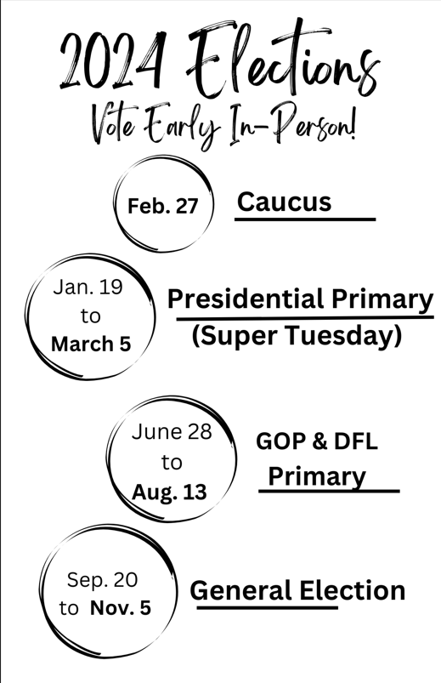
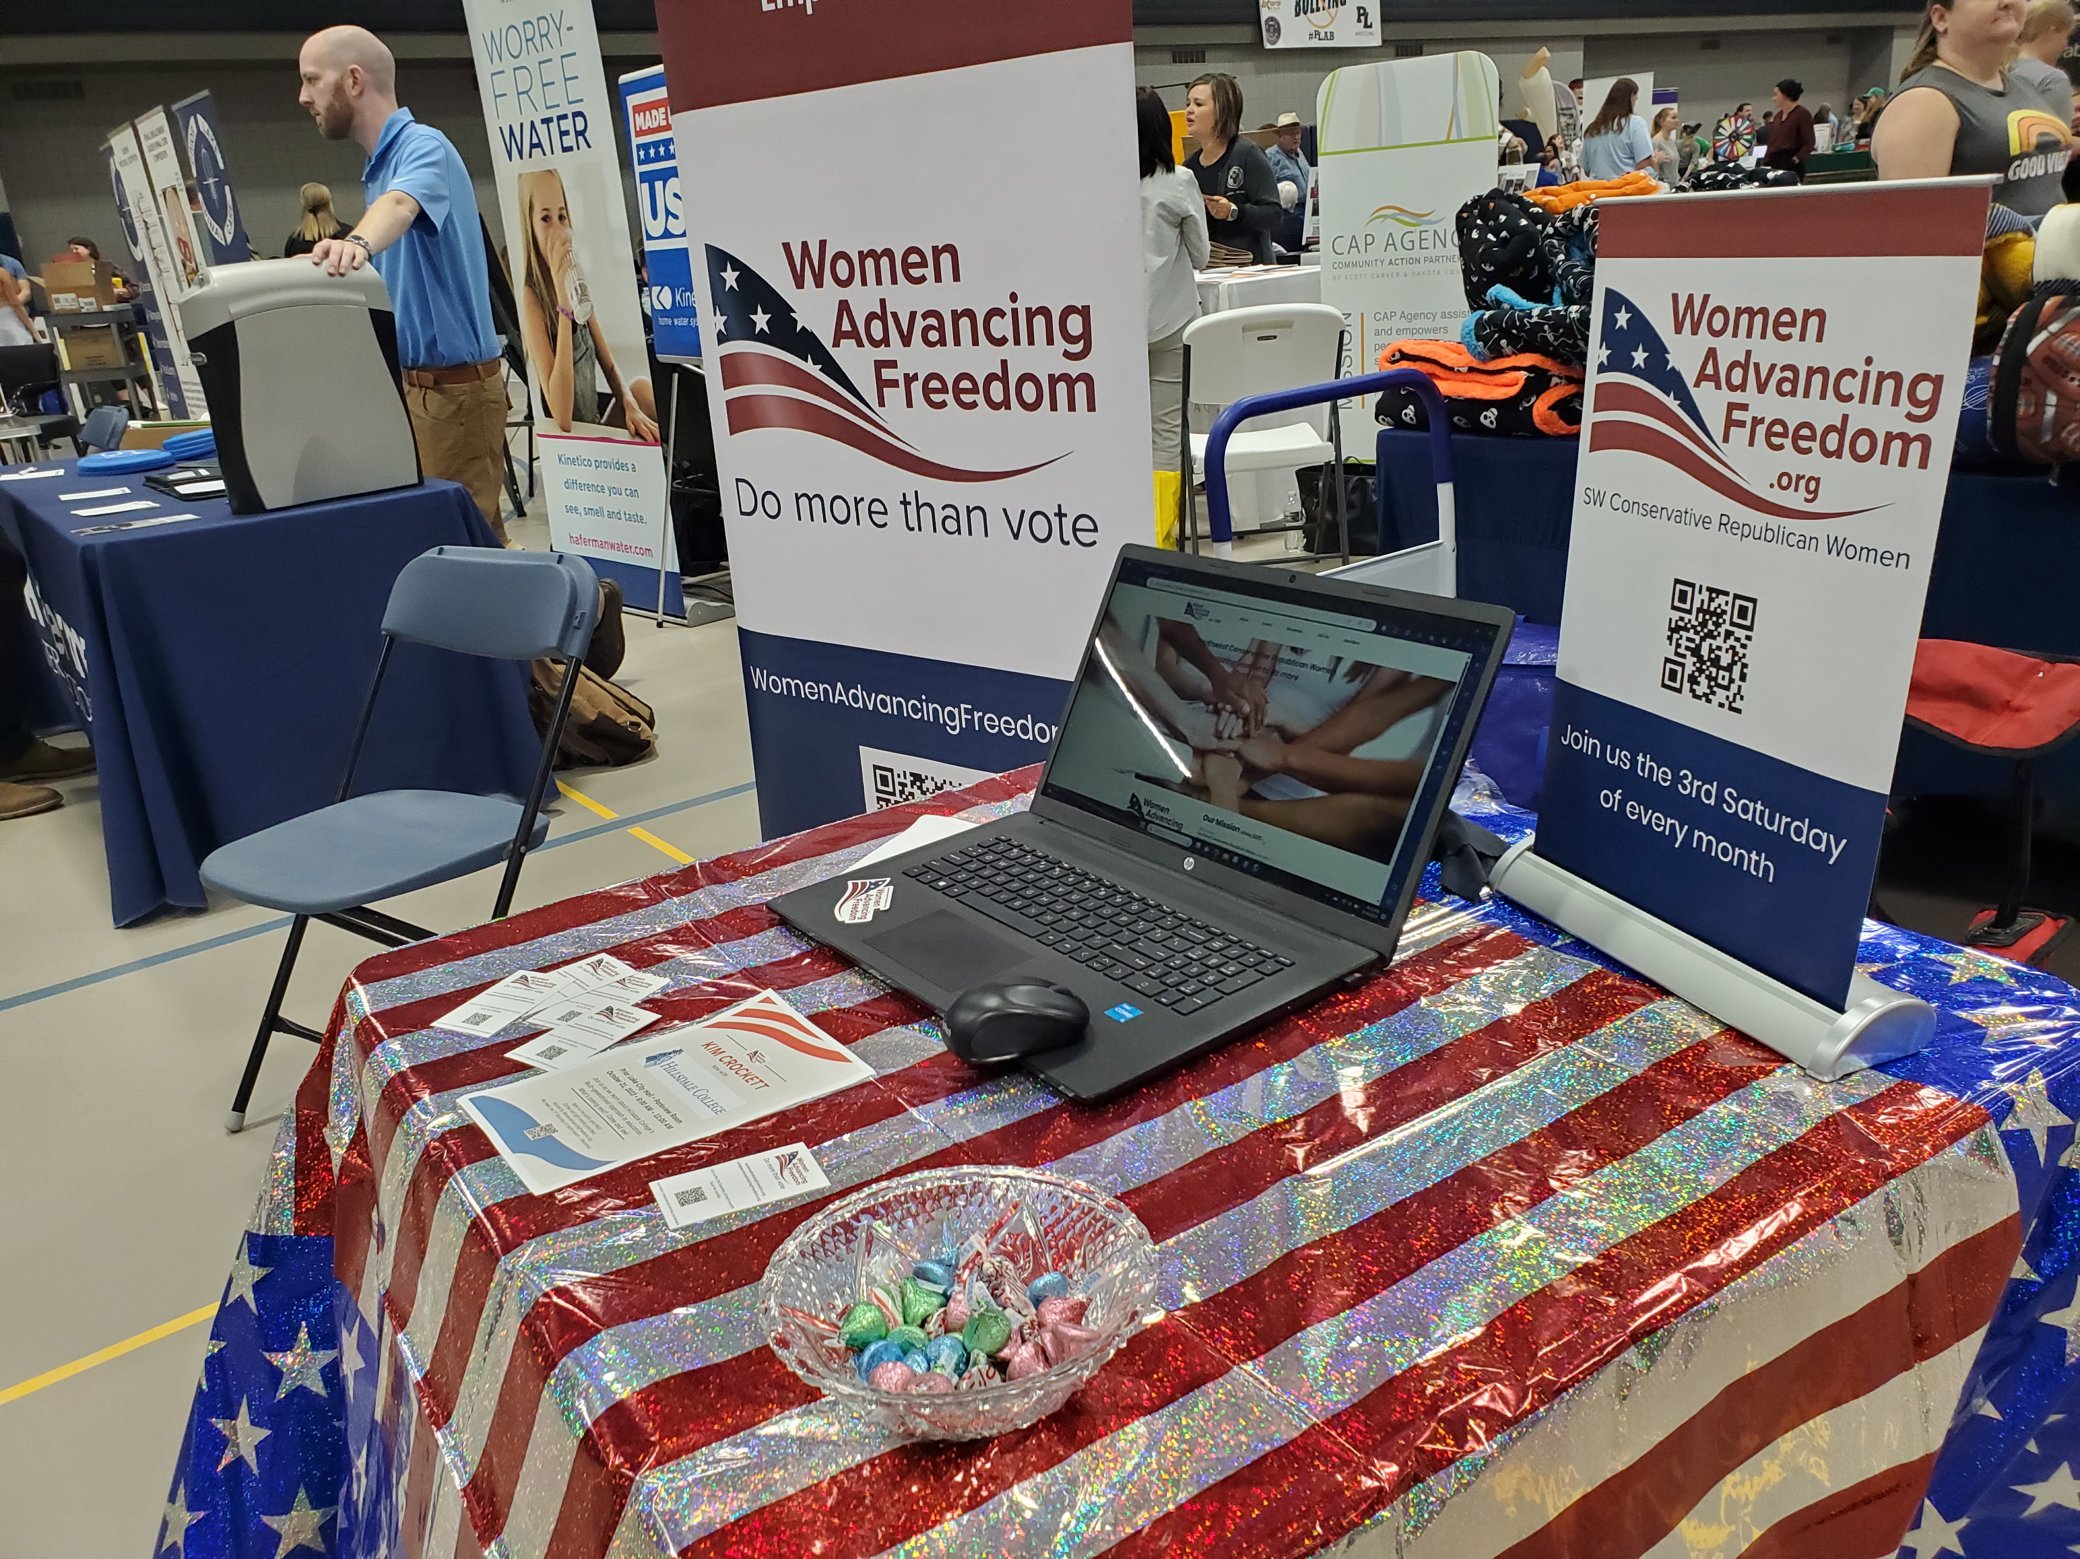
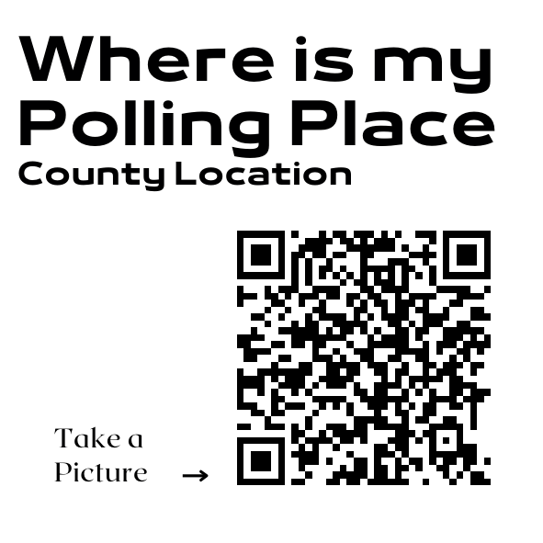
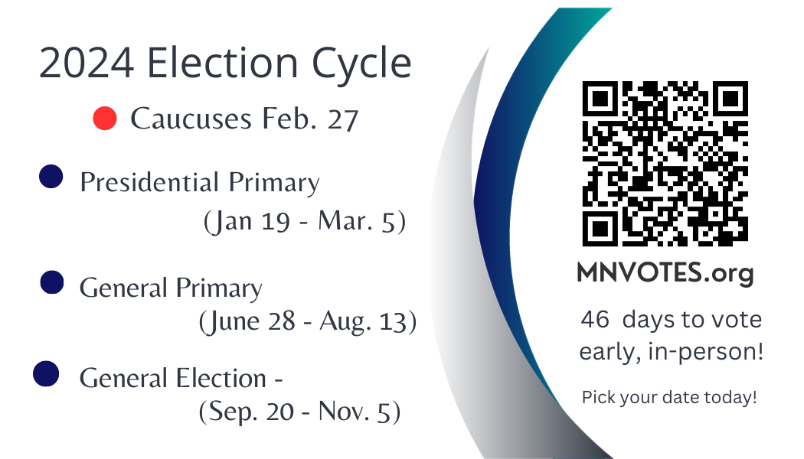
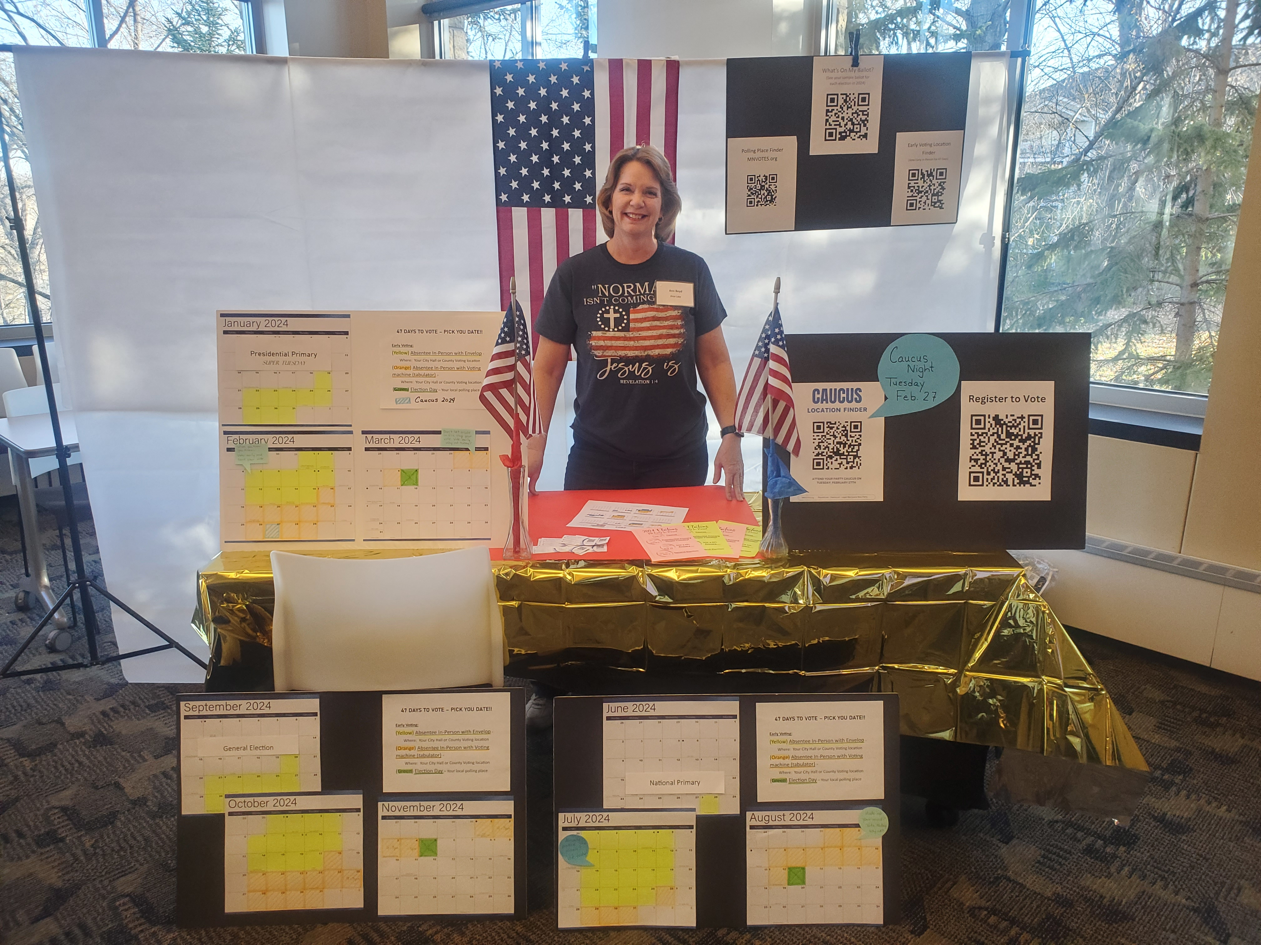
Voter Impact Booth Toolkit
Who & Where
What You Should Include
Resources & Printables

Slide 3
Multiple opportunities to set up Early Voter Displays:
One-time events or recurring displays through the 2026 cycle.
Precinct Caucuses
BPOU Meetings
Conventions
Civic Organizations
Churches
Fairs
1
August 11
General Primary
June 26 – Aug. 11
2
November 3
General Election
Sep. 18 – Nov. 3
3
47 days
47 days

Slide 4
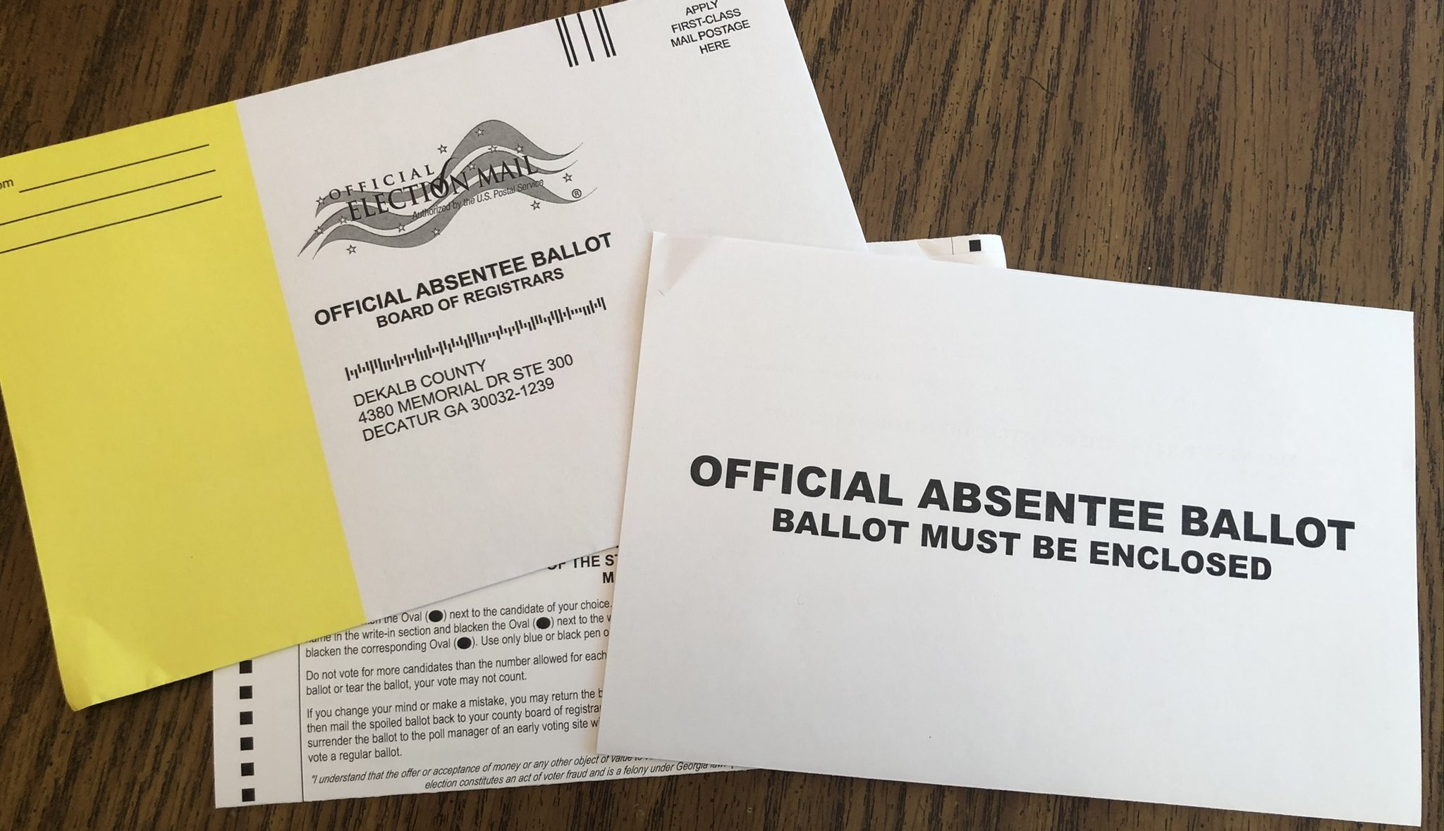
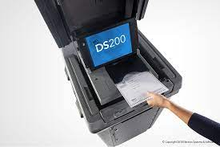
In-Person Absentee Voting New Process
Absentee Voting by Envelope in-person – at City Hall or County Voting Location. They will help you fill it out right there and witness it.
46 days to 19 day before Election Day
Absentee Voting in-person by Tabulator – at City Hall or County Voting Location. It takes 5 min.
18 day before Election Day
Absentee Ballots can be submitted up to 8:00 PM on Election Day at County Voting Locations.

Slide 5

Voter Education Display:
Targeted Locations
Non- Partisan & Ready
Conservative Church
Community Expo or Fair.
Farmer’s Market
Gun Shows
Homeschool Community
Christian Schools
High school graduation events
To be accepted at a church or other public event the goal is to present as non-partisan
Friendly
Welcoming
Informed about the process, willing to use resources to find information.
Tech savvy and paper savvy.
5

Slide 6

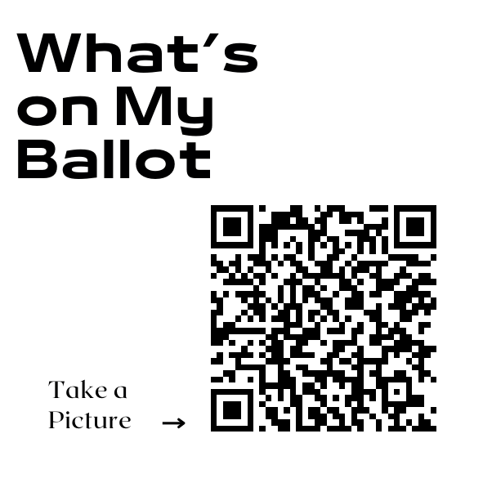
What to include:
QR codes
Decor
Resources
MNVOTES. org
What’s on my Ballot
Where is my Polling Place
Absentee Ballot Request
Register to Vote
Large QR displays
Table clothe that’s patriotic and eye catching
Banner – Voter info Here
Volunteers with smiles
Calendar display
WiFi access
Laptops
Cellphones
Tabs open to SOS sites
Paper list of County Voting Locations
Flyers
Business cards

Slide 7
Banner ideas:
47 days!!
Early Voting
New Voting Rules
New Voting Window
More Ways to Vote

Slide 8
Printables Provided:
QR codes on printable labeled page
  Labeled page and/or QR .png
    Caucus Finder
    Early Voting Locations
    MNVotes.org
    What’s on my Ballot
    Polling place finder for Election day
    Register to Vote
47 Days to Vote key
Flyer – 2 sided half sheets for printing
2026 Election Cycle Calendar

Slide 9
Checklist:
What You’ll Need
LOCATION
Permission and dates
Table and chairs
Backdrop if possible (portable frame & drape)
Tablecloth
Large Printed QR Codes on 8 x 11 (Foam Core board x 2, Dollar store)
Register to vote
What’s on my Ballot
Election Day Voting Location
Voting Locations – Early and Election Day
MNVOTES.org
Caucus Finder
Flyers with Election Calendar (colored paper)
Laptop (power cord and outlet, WiFi access or hotspot)
  SOS website tabs
  2024 Election Toolkit PowerPoint open
Printed list of County Locations
Calendar Display (Dollar store 2024 calendar & highlighters, Foam Core x 3)
Banner or large Flag
2-sided tape is a must!
Volunteers

Slide 10
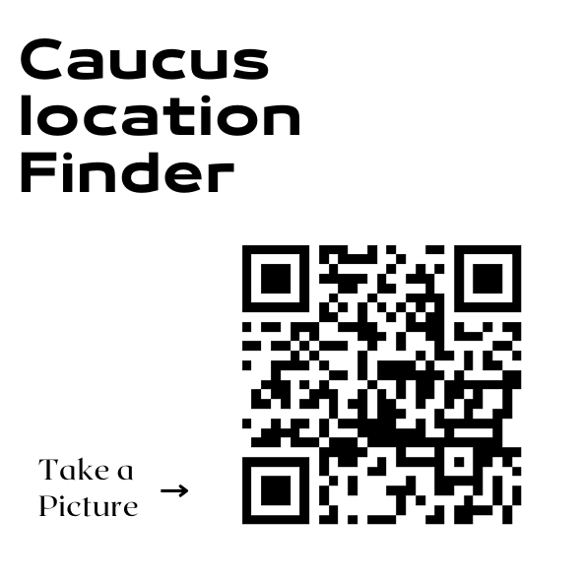
What we have for you to use:
Tip: QR Codes
Generated free at Canva or Vistaprint
Samples of Printables:

Slide 11
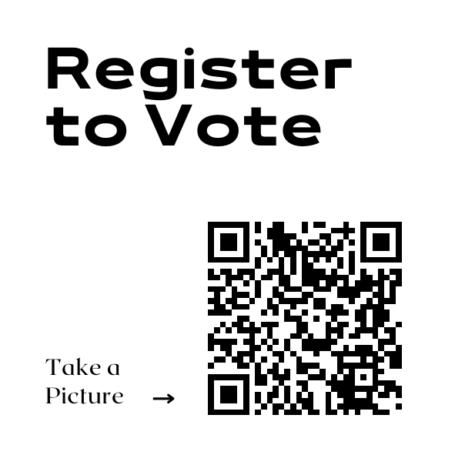
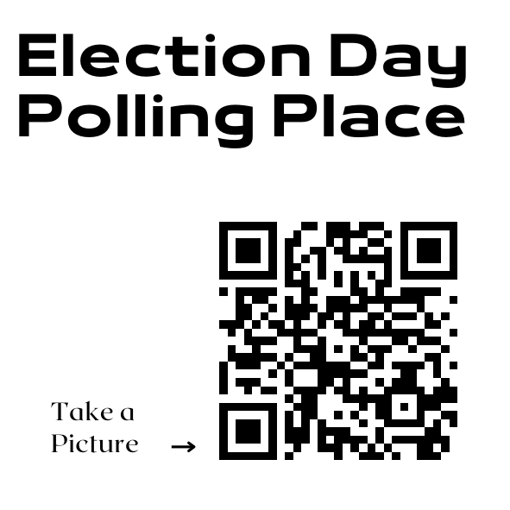

Slide 12
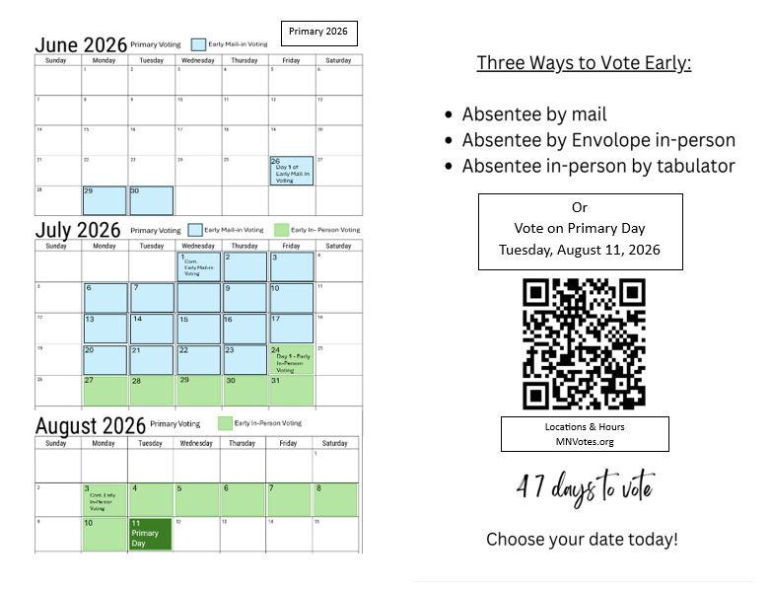
Tip: If you don’t want to
print color, print grey scale
for visual impact.
Printing on colored paper can
make for a more eye-catching
flyer, too.

Slide 13
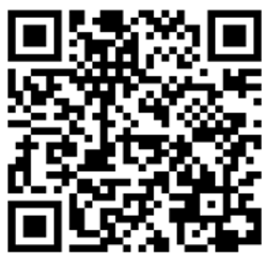
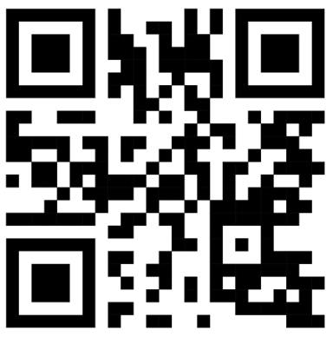
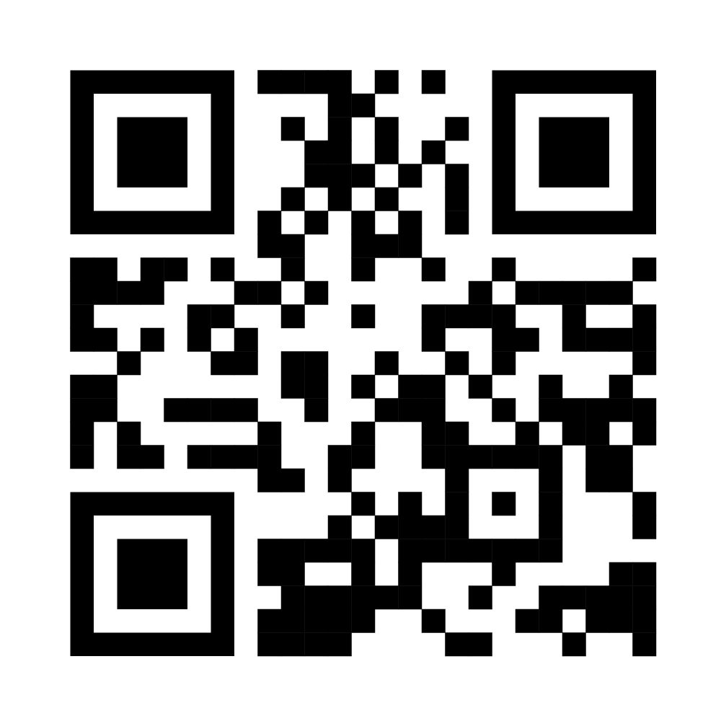
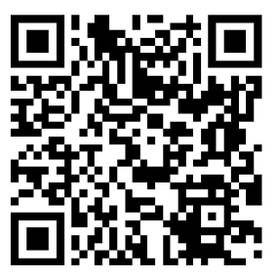
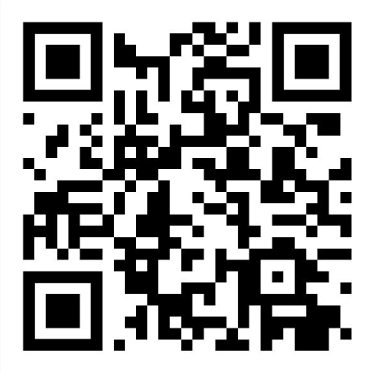
Voter Education “at a glance”
MNVotes.org
Secretary of State Website
Early Voting Locations
What’s on My Ballot
Secretary of State Website
Resource
30” x 20” foam core board
8” x 11” printed QR codes
(Tip: Be sure to separate QR codes
On the page.)
Register
Now!
Find Your
Polling Place

Slide 14
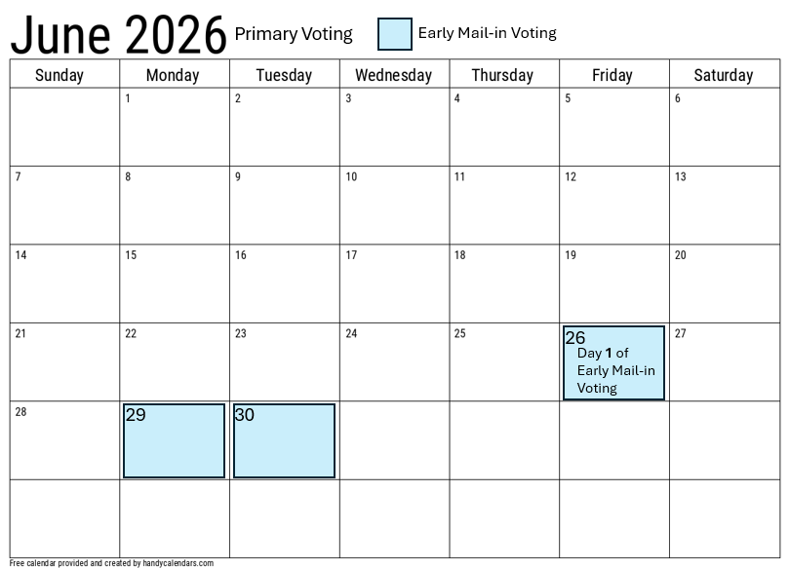
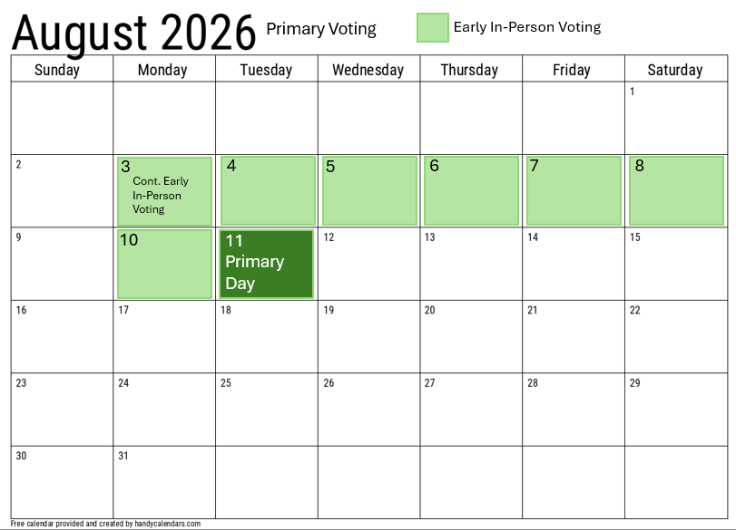
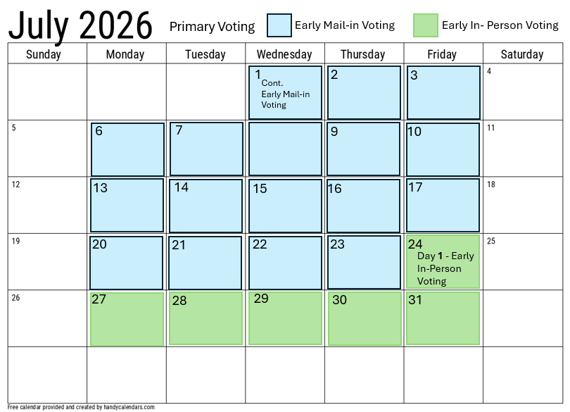
47 days
Mount on 30”x 20”foam core board from the Dollar Store
Tip: for larger calendar, use a desk top calendars with highlighted voting days
These calendars are included in the printable downloads.
(8.5” x 11”)
November election calendar
coming

Slide 15
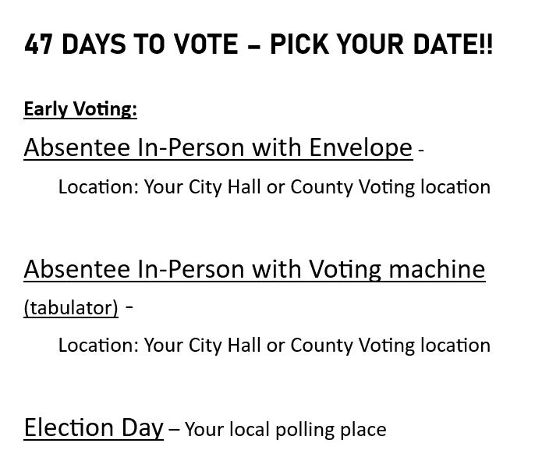
Clear Outline of the new Early voting system.
Tip: We never
Recommend
Mailing ballots

Slide 16
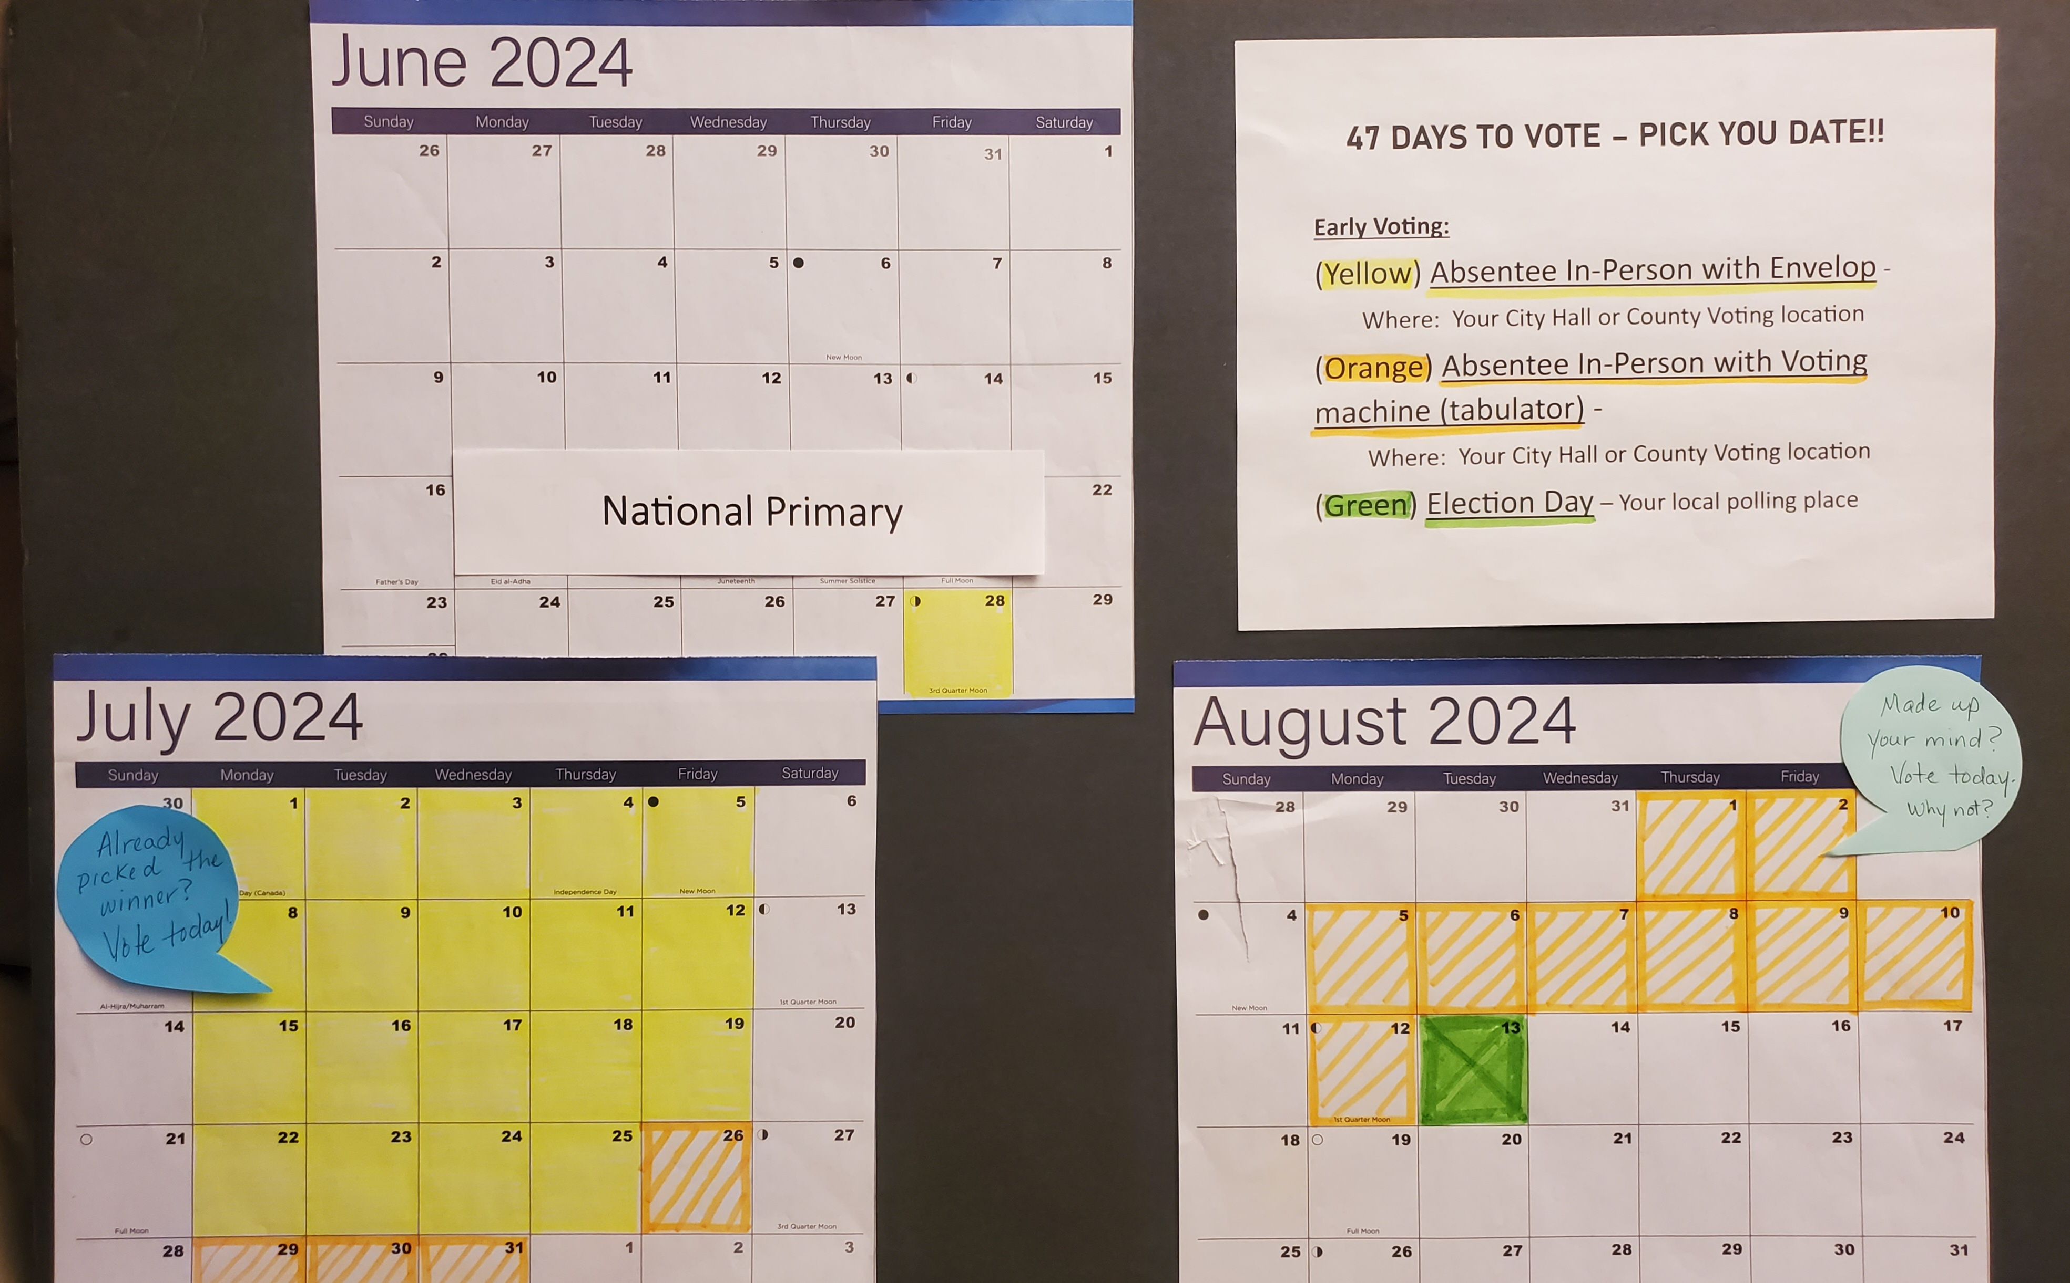
47 days
Sample from 2024:
Desk top calendars with highlighted voting days

Slide 17
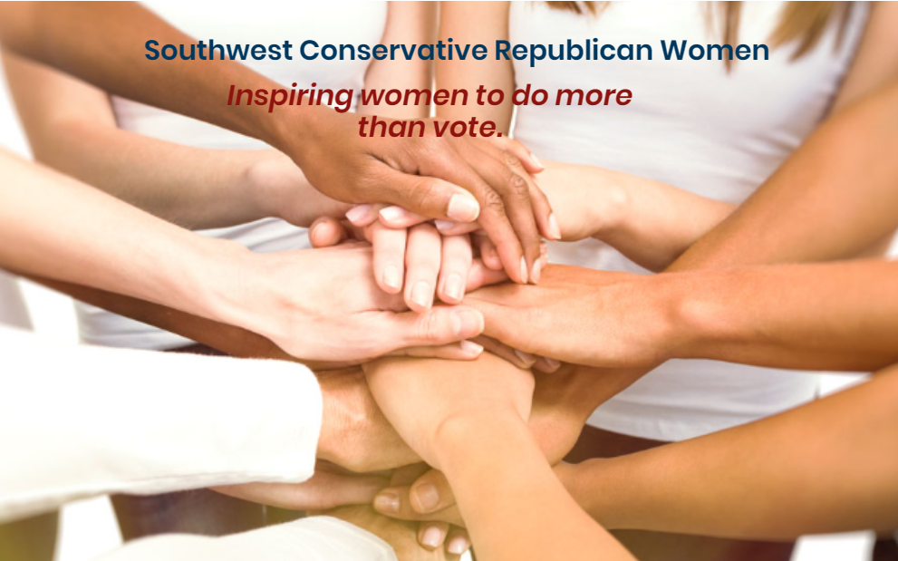
Thank you for your time: Brought to you by a Federation of Republican Women local club.
WomenAdvancingFreedom.org

