Slide 1
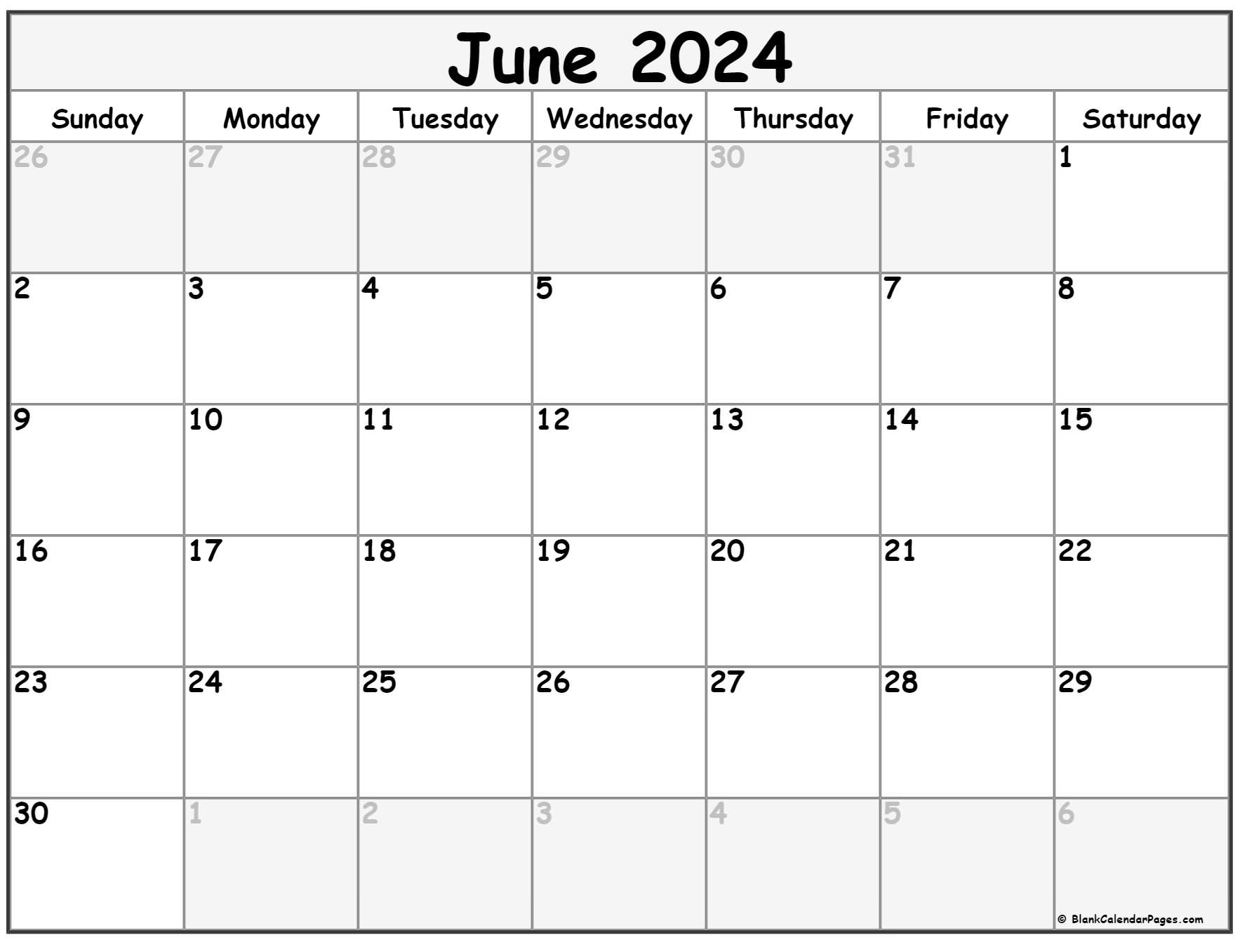
First Day to Vote
28

Slide 2
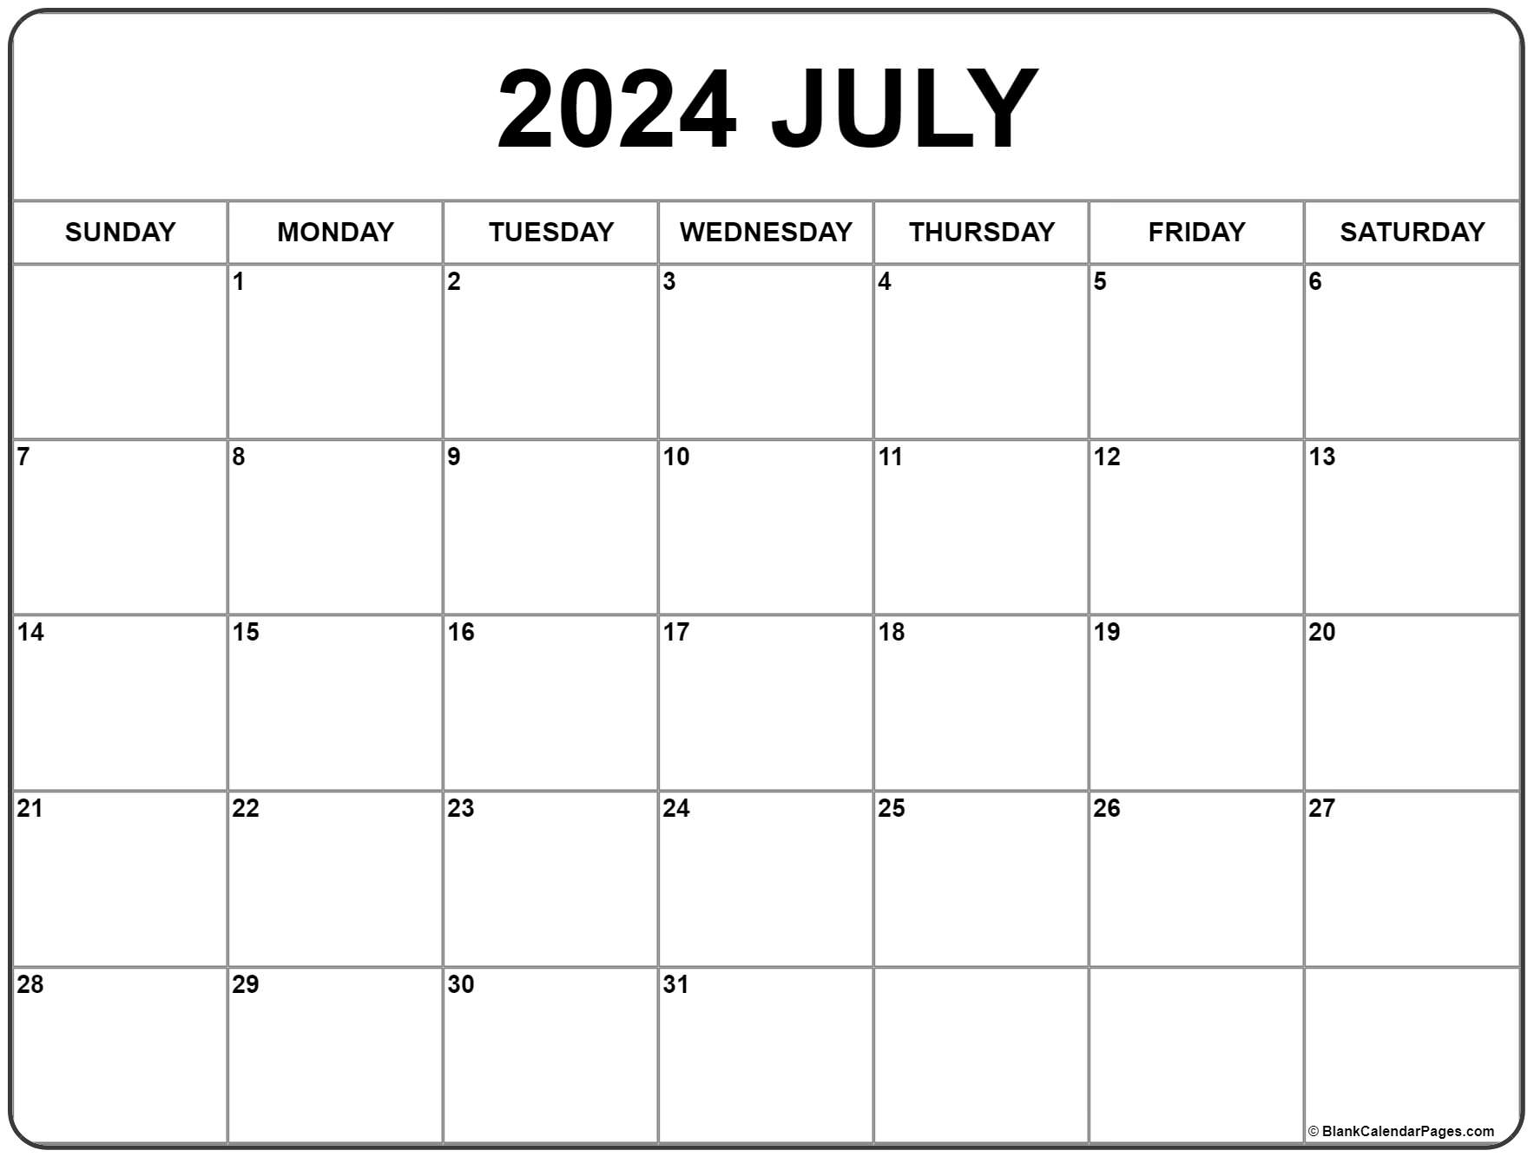
In Person Absentee Voting
By Envelop at City Hall or
County Voting Location
Begin In Person
Early Voting by
Tabulator

Slide 3
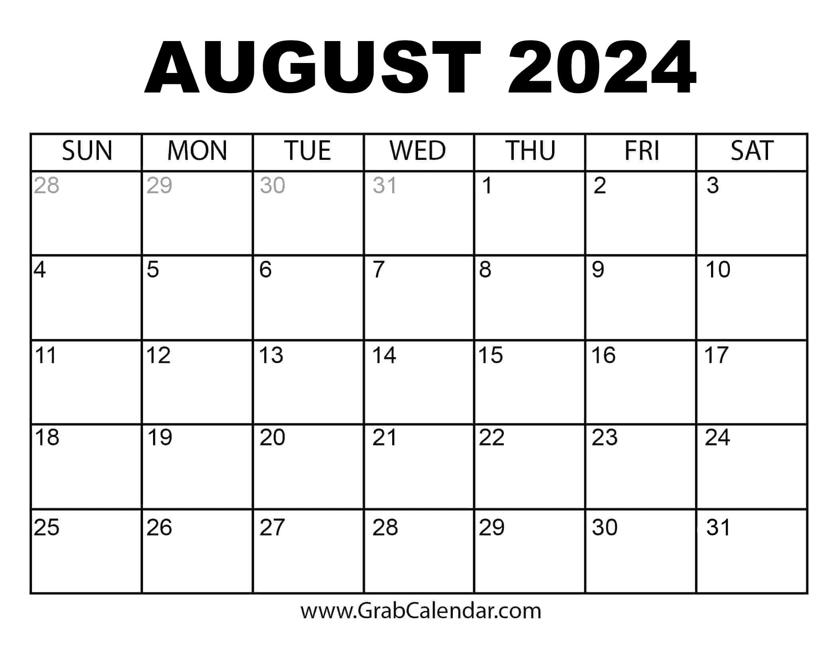
In Person Early Voting by Tabulator
Primary
Day

Slide 4
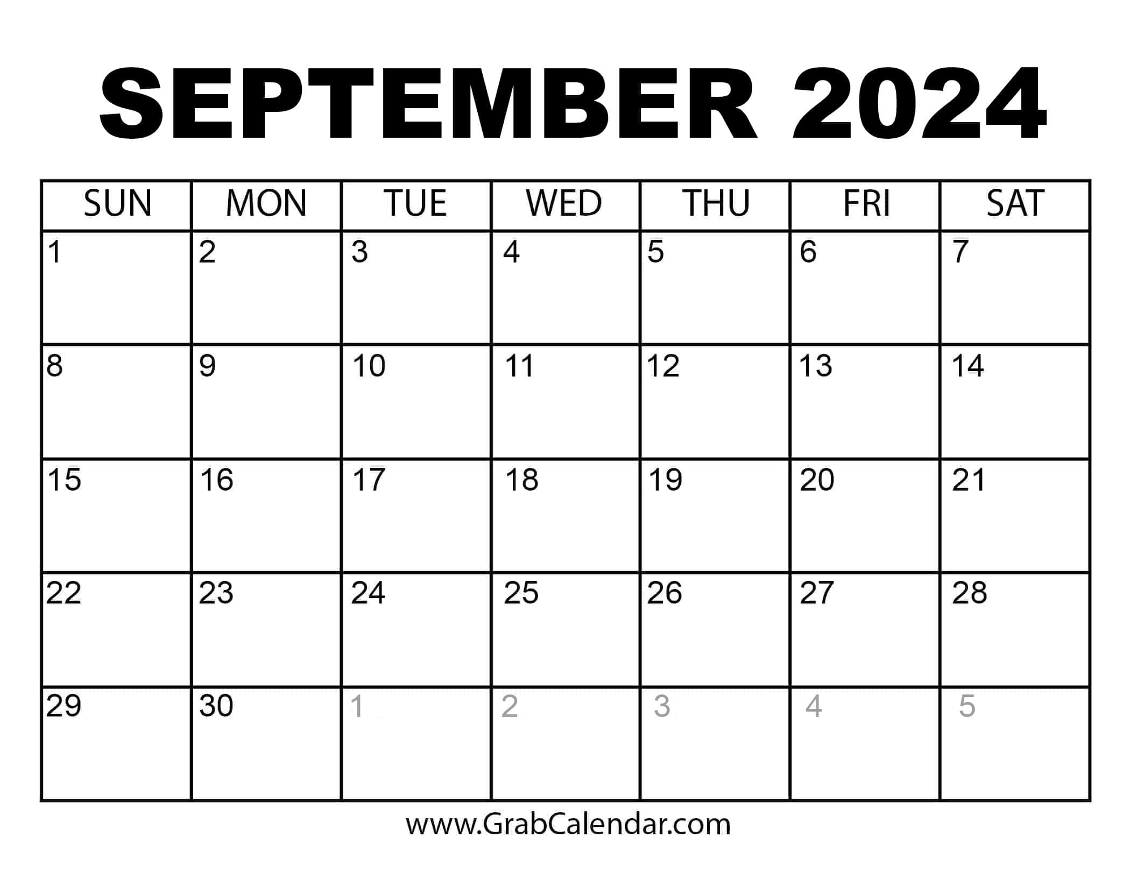
20
First Day
To Vote
Begin In Person Early Voting by Envelope

Slide 5
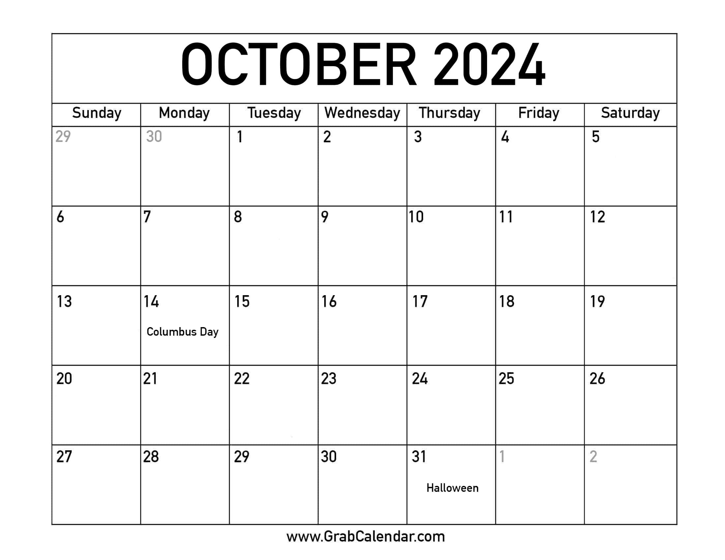
In Person Absentee Voting
By Envelop at City Hall or
County Voting Location
Begin In Person
Early Voting by
Tabulator
In Person Early Voting by Tabulator

Slide 6
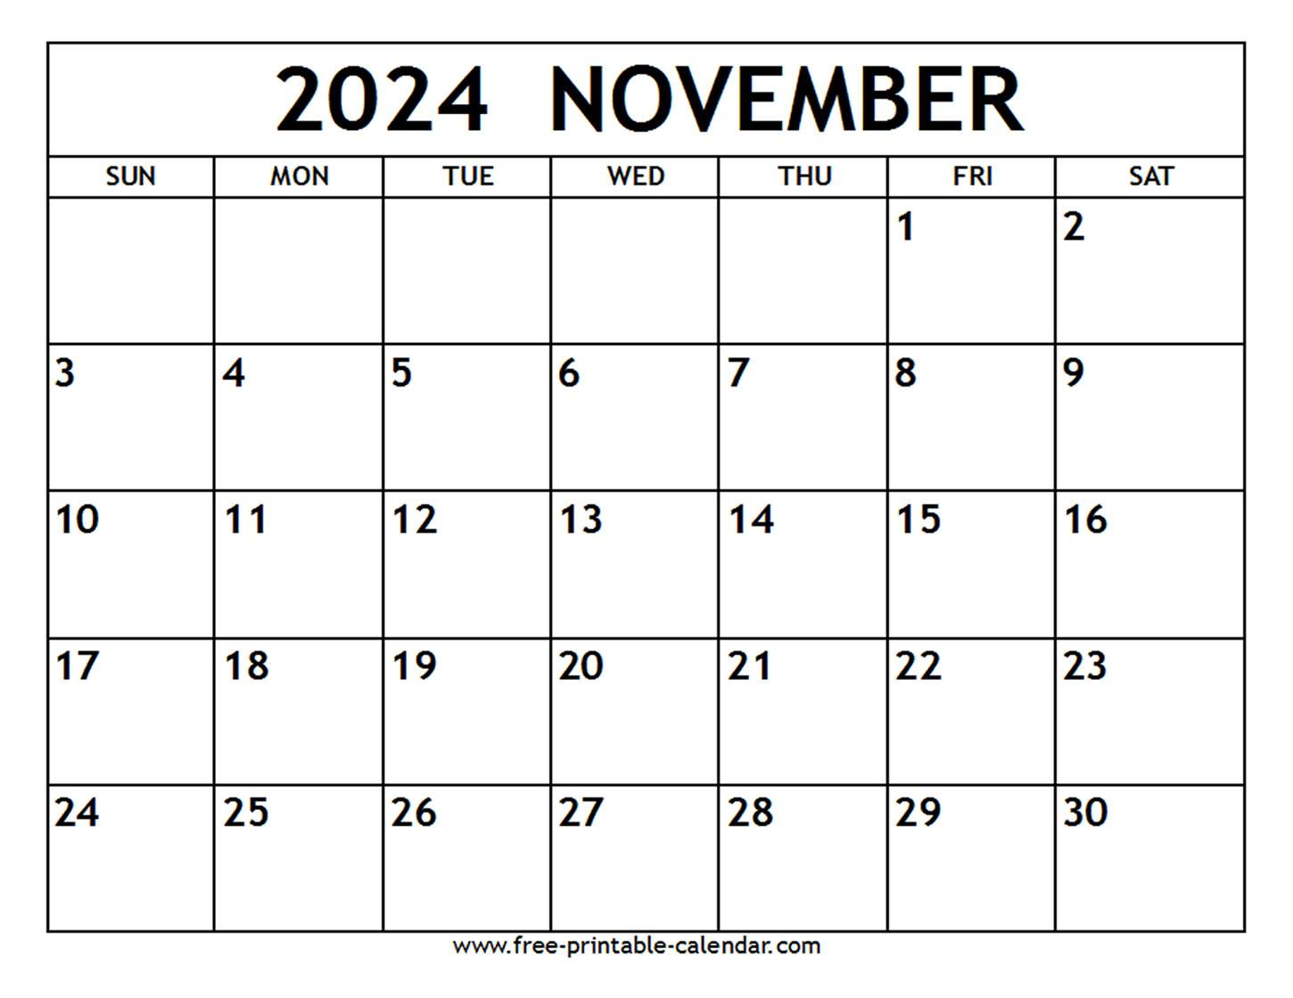
General
Election
Day

