Slide 1
2024 Election Toolkit

Slide 2
New Early Voting Process Explained & Voter Education Toolkit for Displays
Everything a BPOU, church, club or volunteer needs to register, educate, and GET OUT THE VOTE in 2024!

Slide 3
First the New Early Voting Changes
47 days to Vote
Pick your date today!!!

Slide 4
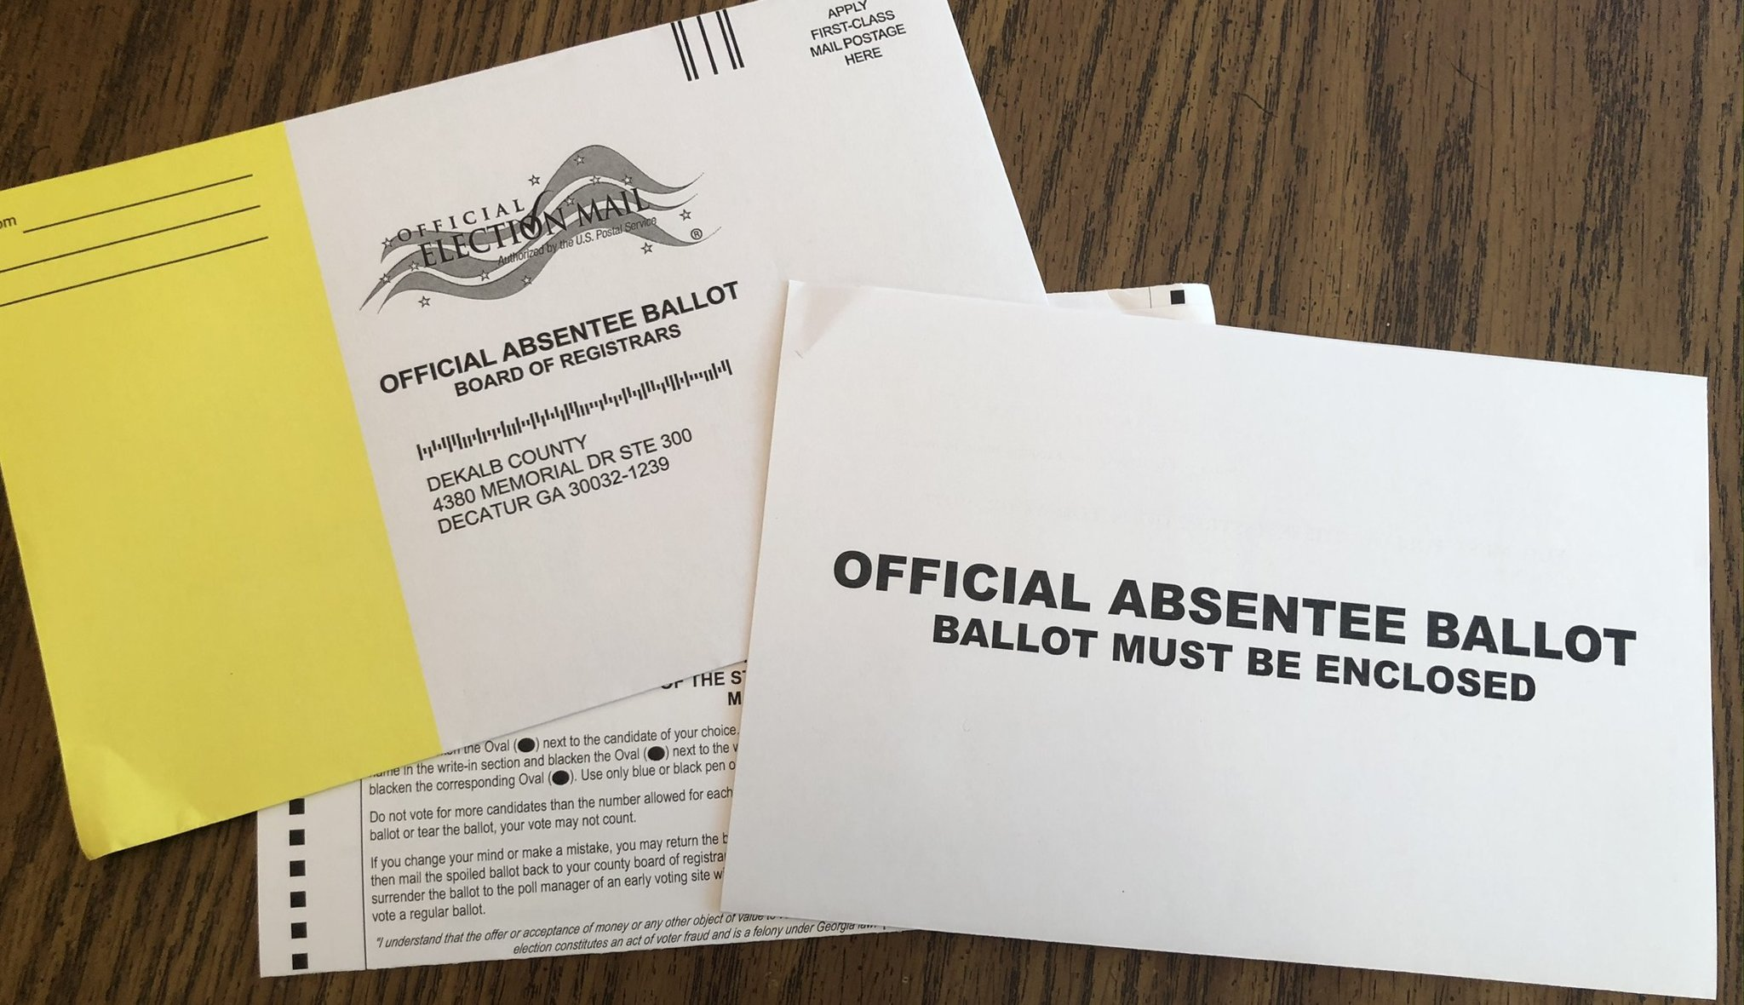
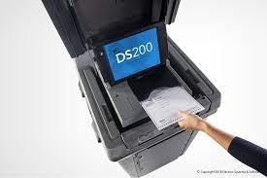
In-Person Absentee Voting New Process
1. Absentee Voting by Envelope in-person – at City Hall or County Voting Location. They will help you fill it out and witness it right there.
46 days to 19 day before Election Day
2. Absentee Voting in-person by Tabulator – at City Hall or County Voting Location. It takes 5 min.
18 day before Election Day
Absentee Ballots can be submitted up to 8:00 PM on Election Day at County Voting Locations.

Slide 5
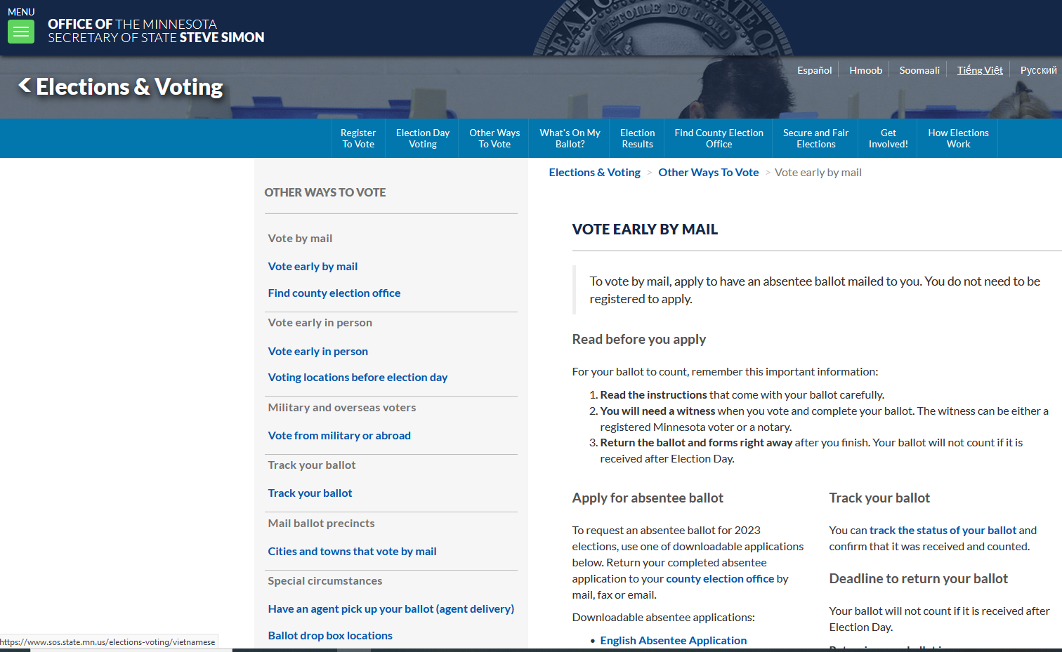
Absentee Request (Digital)
3. Absentee Voting by envelope – MNVOTES.org
https://www.sos.state.mn.us/elections-voting/other-ways-to-vote/vote-early-by-mail/
Process:
Fill out Digital form
Ballot received in the mail
Fill out ballot
(a) Return by mail
(b) Return to County voting location by
8 PM election day.

Slide 6
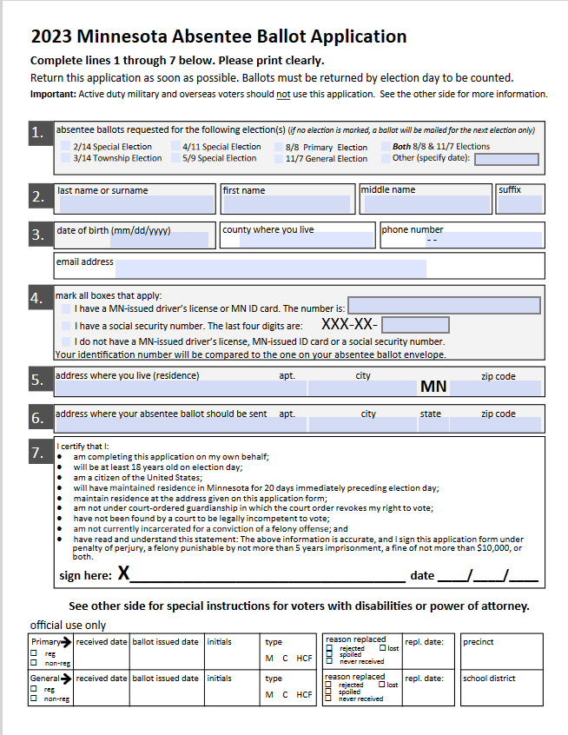
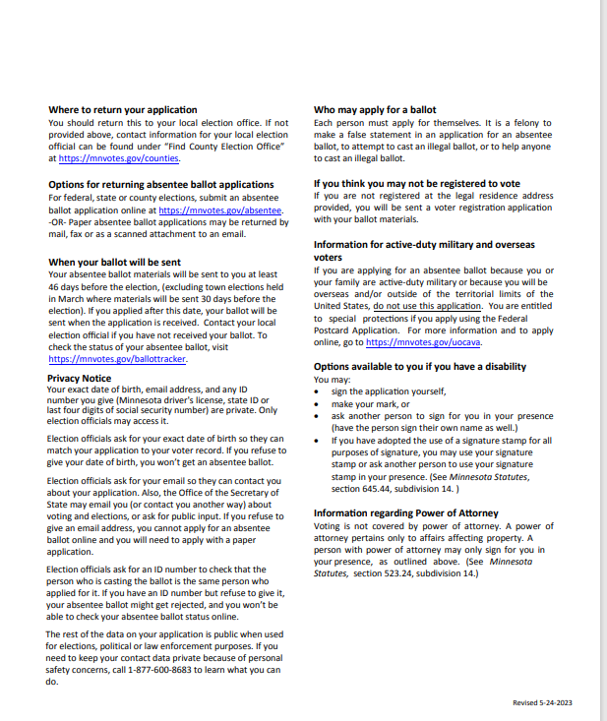
Digital form to fill out and submit online to be mailed an Absentee Ballot: :

Slide 7
Where to bring your Absentee Ballot -
Where you gotit , is where you submit it.
Pick it up at the City Hall – submit
back to City Hall
Request a ballot from MNVOTES.org – bring or mail to County voting location
You have until 8 PM on Election Day to submit your ballot regardless of when you received it or picked it up.

Slide 8
Election Timetable
All In- Person Voting
 | AB by Envelope |  | 1st Day AB Tabulator | Election Day
1 | - |  | - | Feb 27- Caucus
47 | Jan. 19 |  | Feb. 16 | March 5 – Presidential Primary (Super Tues.)
47 | June 28 |  | July 26 | Aug 13 - Primary
47 | Sept. 20 |  | Oct. 18 | Nov. 5 - Election
Days to Vote

Slide 9
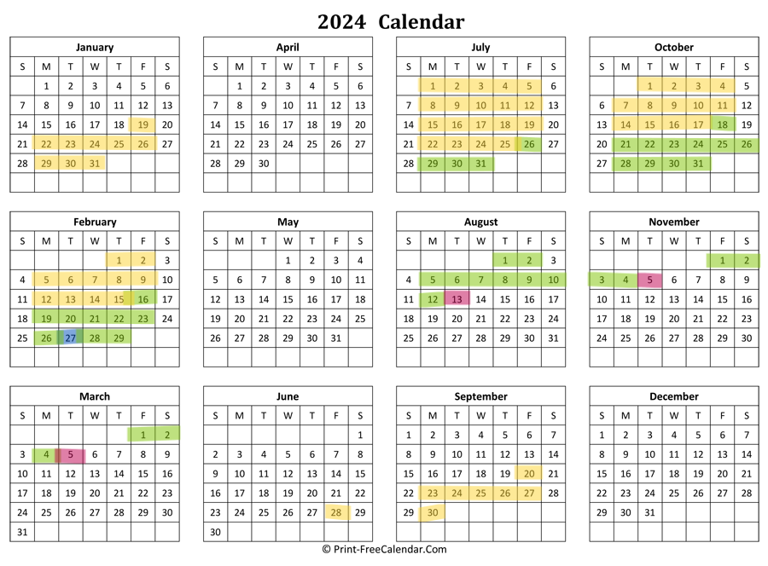
Presidential Primary
Calendar key:
Caucuses– (Blue) Feb 27
Absentee Ballot Envelope –
(Yellowish) At City Hall,
County Location or mail to
County location.
Absentee Ballot Tabulator –
(Green) At City Hall or
County Location.
Election Days – (Purple)
Jan. 19 - March 5
June 28 - August 13
Sep. 20 - November 5
General Election
Primary Election

Slide 10
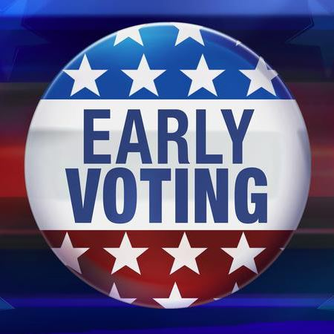
What happens to my Absentee Ballot?
In-Person Envelope
Envelope – mail or hand
In-Person By Tabulator
Envelopes are “banked” in a secure location and opened on Last day of AB by Envelope voting. They are then opened to compare envelope signature to ballot signature.
Number of ballots counted and then fed into tabulator.
8:00 PM Election Day all AB votes are tabulated.
Ballot board is convened to open envelopes and compare signatures weekly.
They are secured until 18 days before election day when they are fed into tabulator.
8:00 PM Election Day votes are tabulated.
Stored in secure tabulator until full, they are then banked in a secure location until Election night at 8:00 PM, when they are put through the tabulators to be vote counted.

Slide 11
What about Drop Boxes?
Scott County
Hennepin County
Dakota County?
No Drop boxes
Drop locations manned by election judges at City Hall or the County voting location.
Each County voting location will have a monitored drop box as well.
No Drop boxes
Drop locations manned by election judges at City Hall or the County voting location.
Each County voting location will have a monitored drop box as well.
At this time they have not gotten direction from the county.

Slide 12
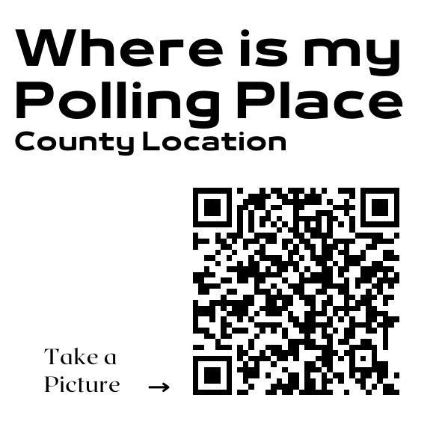
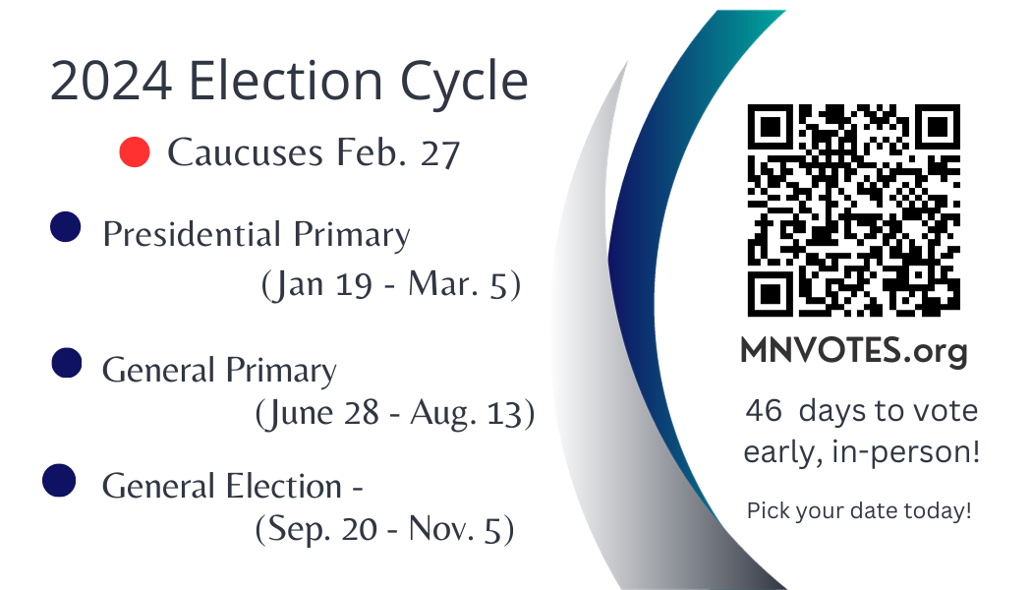
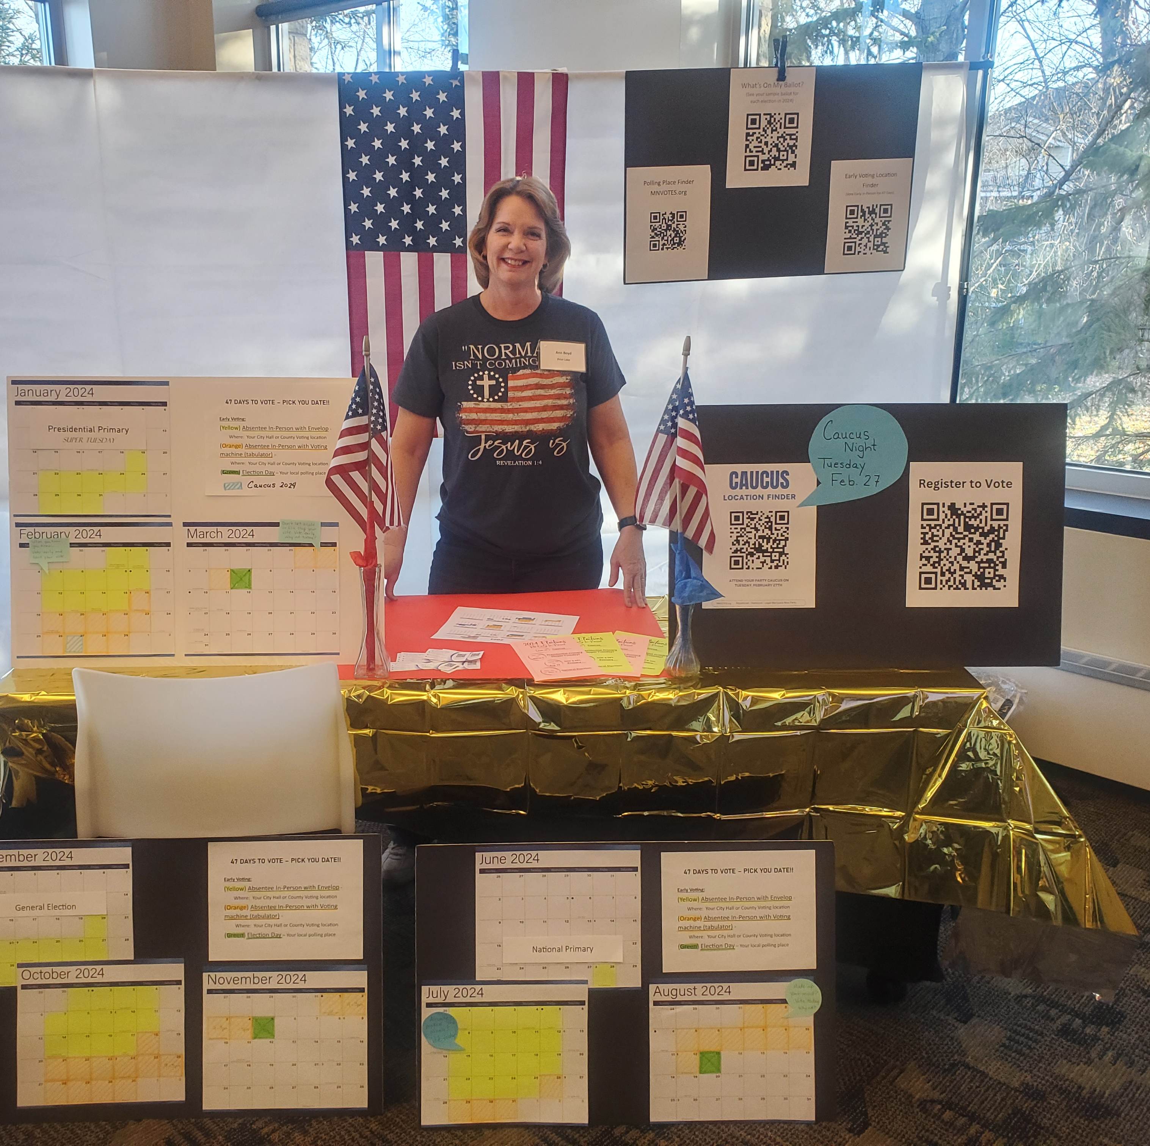
Part 2 – Toolkit for Voter Education
Who & Where
What You Should Include
Resources & Printables

Slide 13
Multiple opportunities to set up Early Voter booths: One-time events or recurring displays
February 27th Precinct Caucuses
1
March 5
Presidential Primary
(Super Tuesday!)
Jan. 19 – Mar. 5
2
August 13
General Primary
June 28 – Aug. 13
3
November 5
General Election
Sep. 20 – Nov. 5
4

Slide 14
Voter Education Display:
Targeted Locations
Non- Partisan & Ready
Conservative Church
Community Expo or Fair.
Farmer’s Market
Gun Shows
Homeschool Community
Christian Schools
High school graduation events
To be accepted at a church or other public event the goal is to present as non-partisan
Friendly
Welcoming
Informed about the process, willing to use resources to find information.
Tech savvy and paper savvy.
14

Slide 15
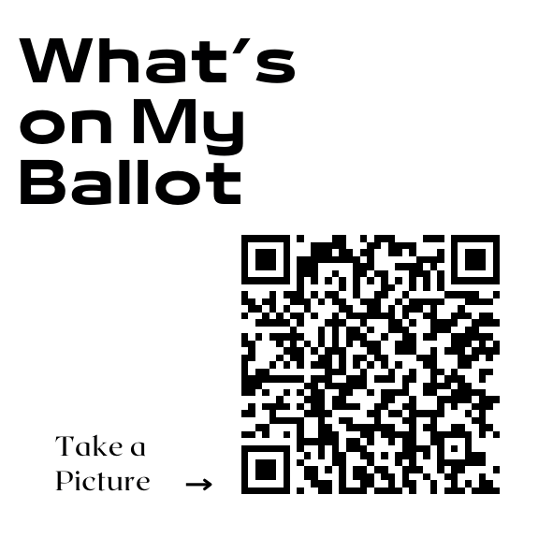
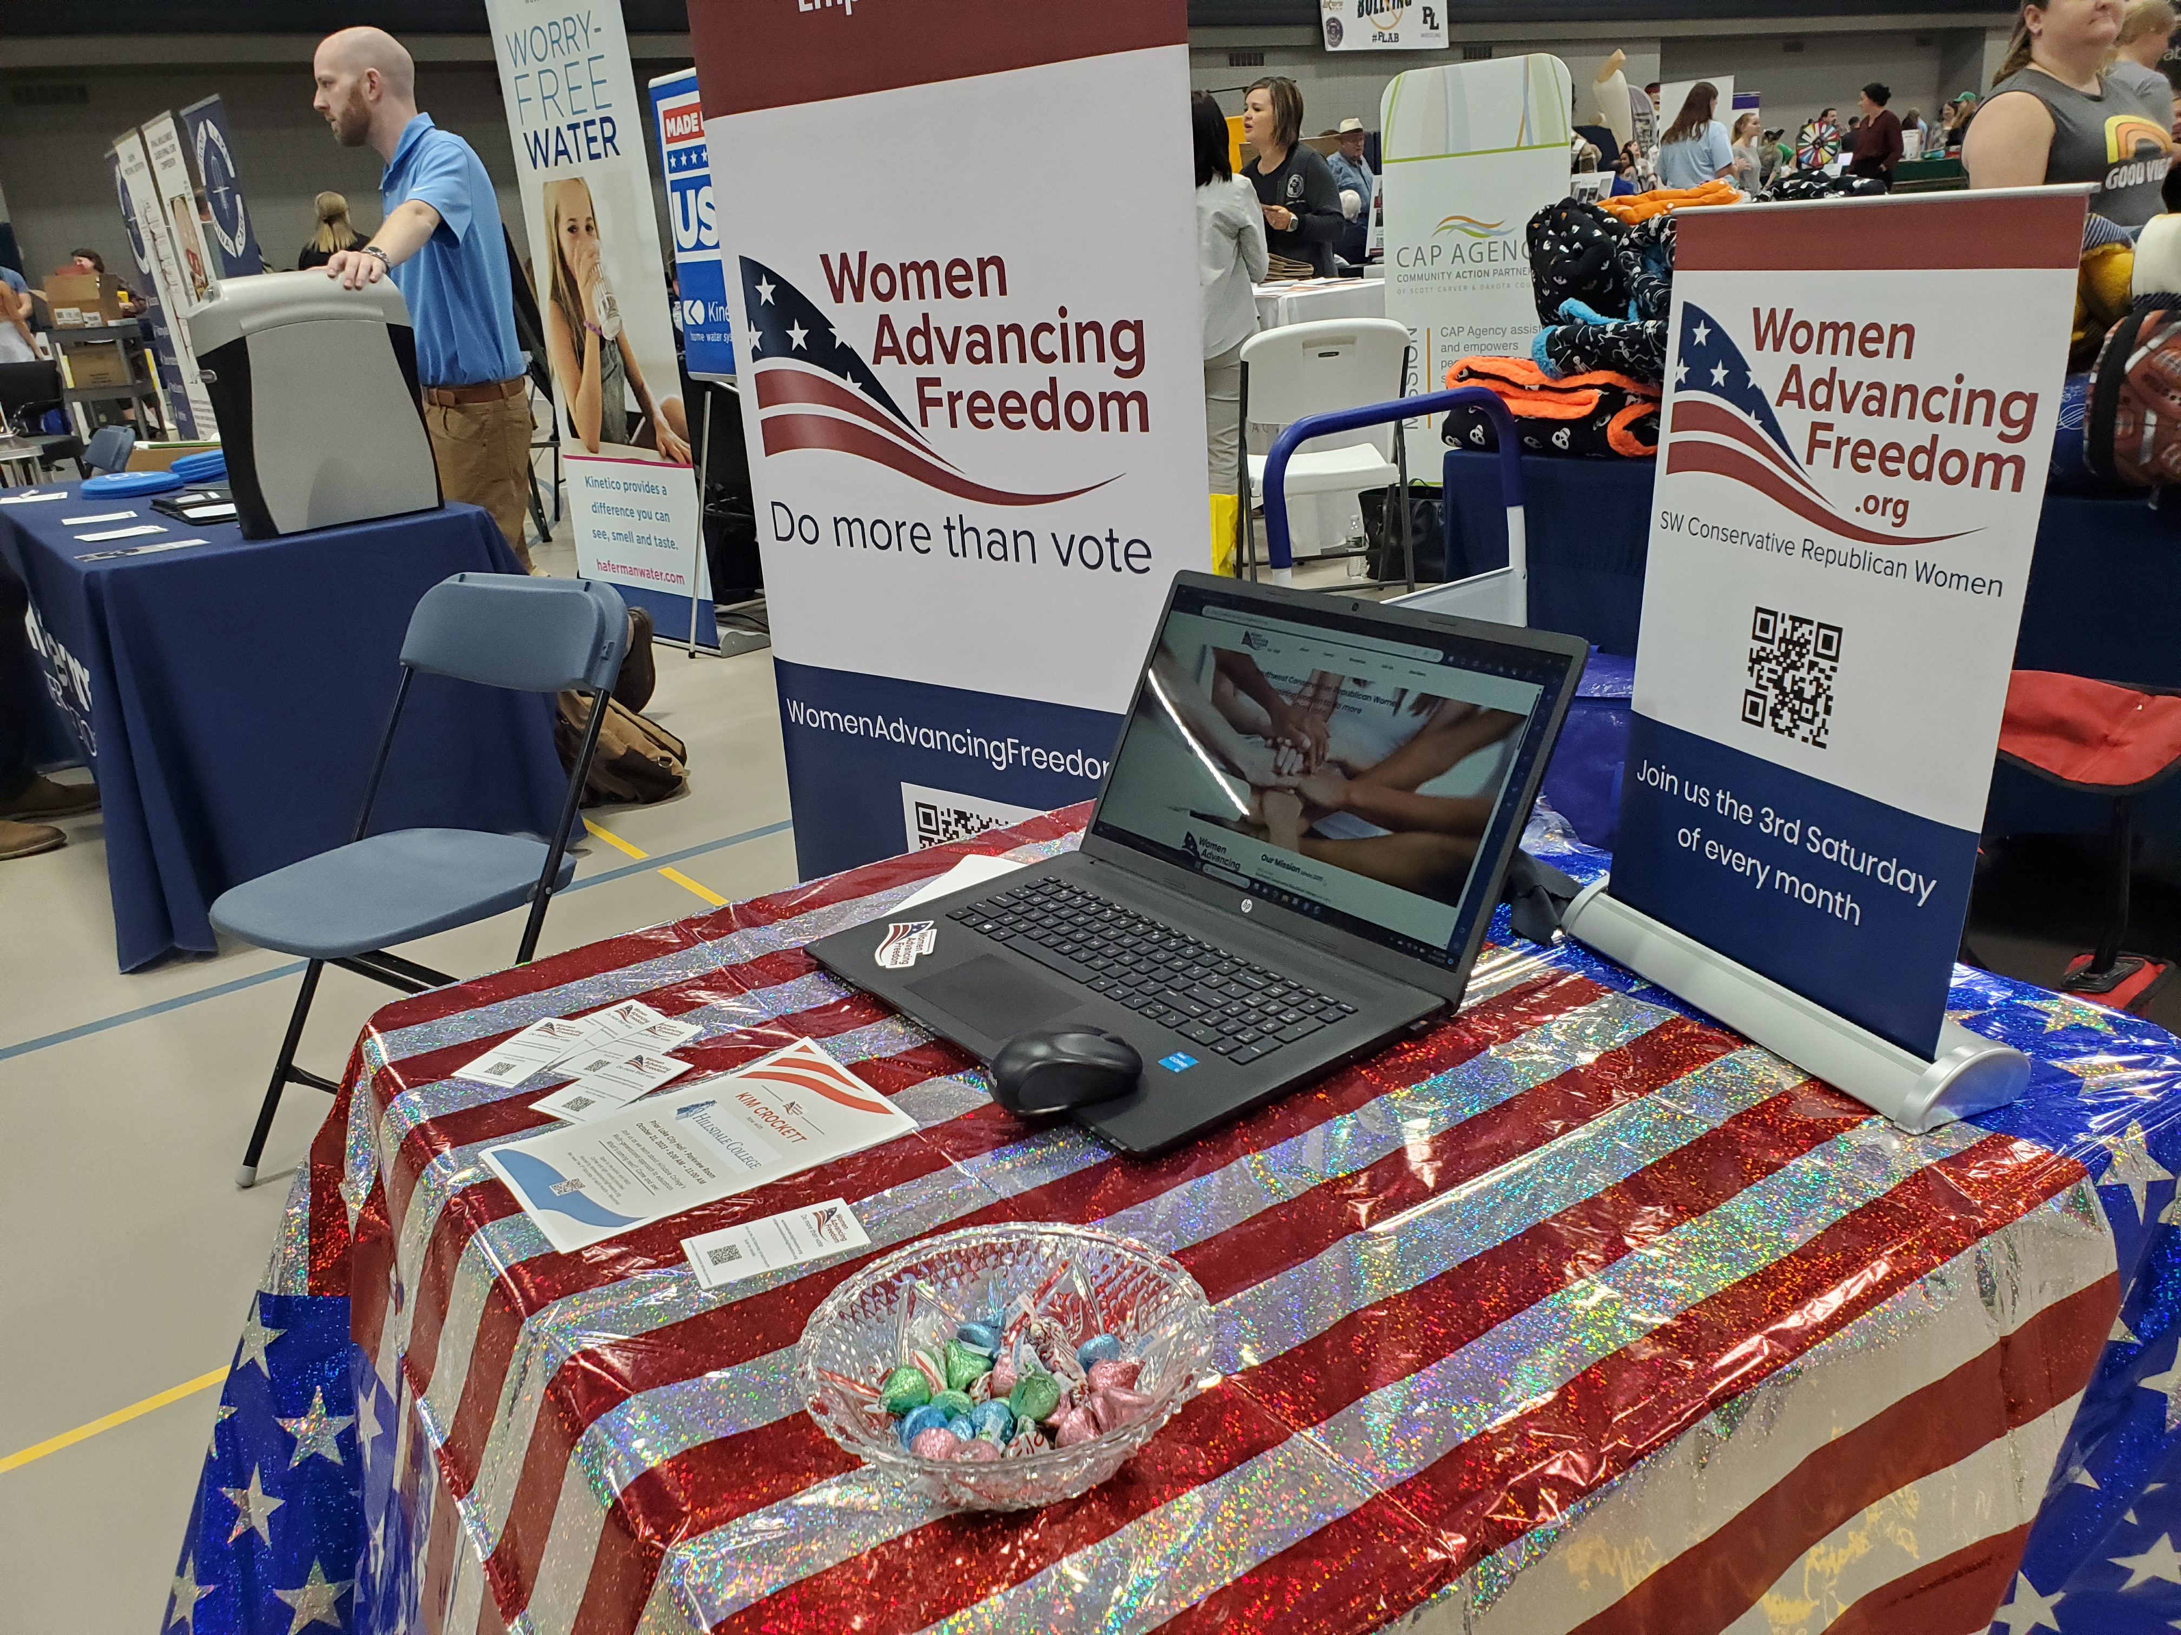
What to include:
QR codes
Decor
Resources
MNVOTES. org
What’s on my Ballot
Where is my Polling Place
Absentee Ballot Request
Register to Vote
Large QR displays
Table clothe that’s patriotic and eye catching
Banner – Voter info Here
Volunteers with smiles
Calendar display
WiFi access
Laptops
Cellphones
Tabs open to SOS sites
Paper list of County Voting Locations
Flyers
Business cards

Slide 16
Banner ideas:
47 days!!
Early Voting
New Voting Rules
New Voting Window
More Ways to Vote

Slide 17
Printables Provided:
QR codes on printable labeled page
Caucus Finder
Early Voting Locations
MNVotes.org
Polling place Finder
What’s on my Ballot
Polling place on Election day
Register to Vote
Election Titles to clip
47 Days to Vote key
2-sided flyer
Business card template to print

Slide 18
Checklist: What You’ll Need
Large Printed QR Codes
(on 8 x 11 + Foam Core board x 4, 2-sided tape)
Register to vote
What’s on my Ballot
Election Day Voting Location
Voting Locations – County
Caucus Finder
Business cards with MNVOTES.org & Election dates 2024
(cardstock paper to print if needed)
Flyers with Election Calendar (colored paper)
Laptop (power cord and outlet, WiFi access or hotspot)
SOS website tabs
2024 Election Toolkit PowerPoint open
Printed list of County Locations
Calendar Display (Dollar store 2024 calendar & highlighters)
Banner or large Flag
Volunteers
LOCATION
Permission and dates
Table and chairs
Backdrop if possible (portable frame & drape)
Tablecloth

Slide 19
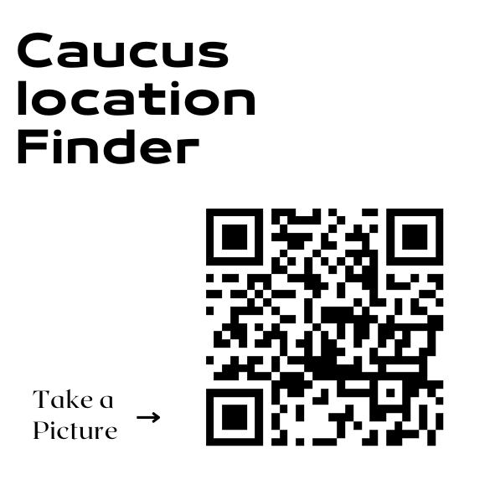
QR Codes Generated free at Canva or Vistaprint
Samples of Printables:

Slide 20
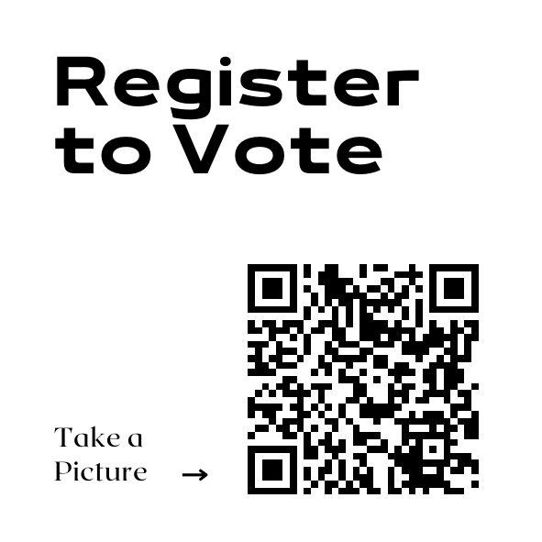
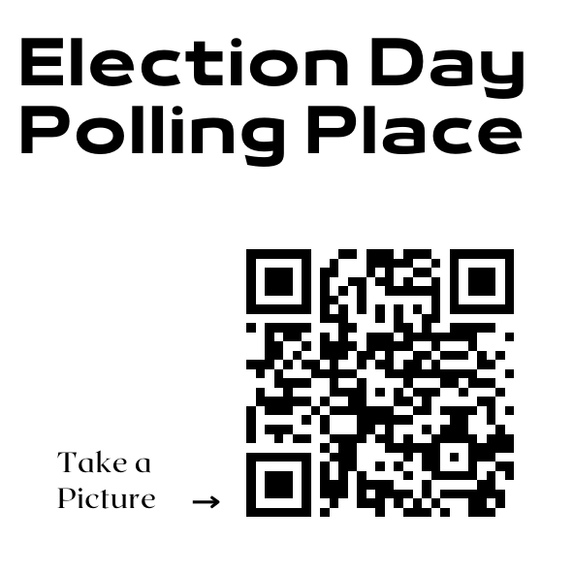

Slide 21
Business card calendars:

Slide 22
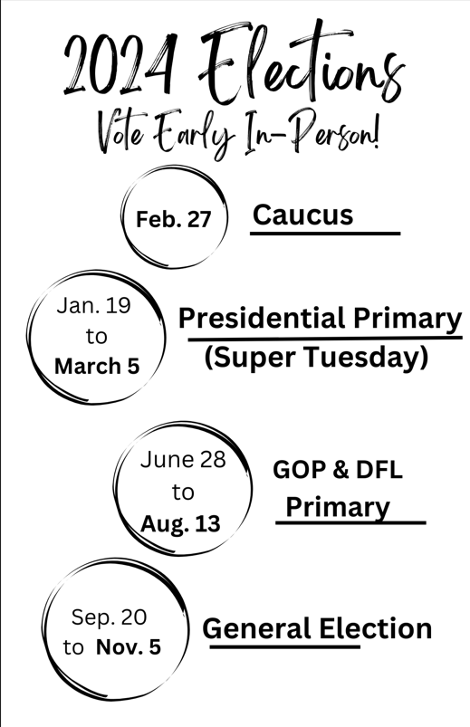
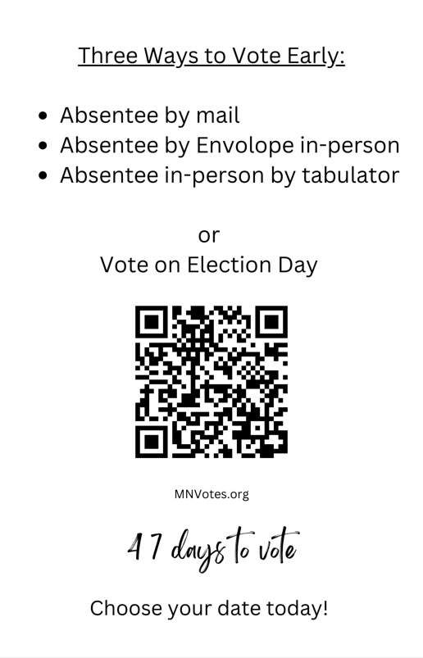
Tip: To save $money print on
pastel colored paper for
eye catching color without the
cost of custom copies.
(2 sided)

Slide 23
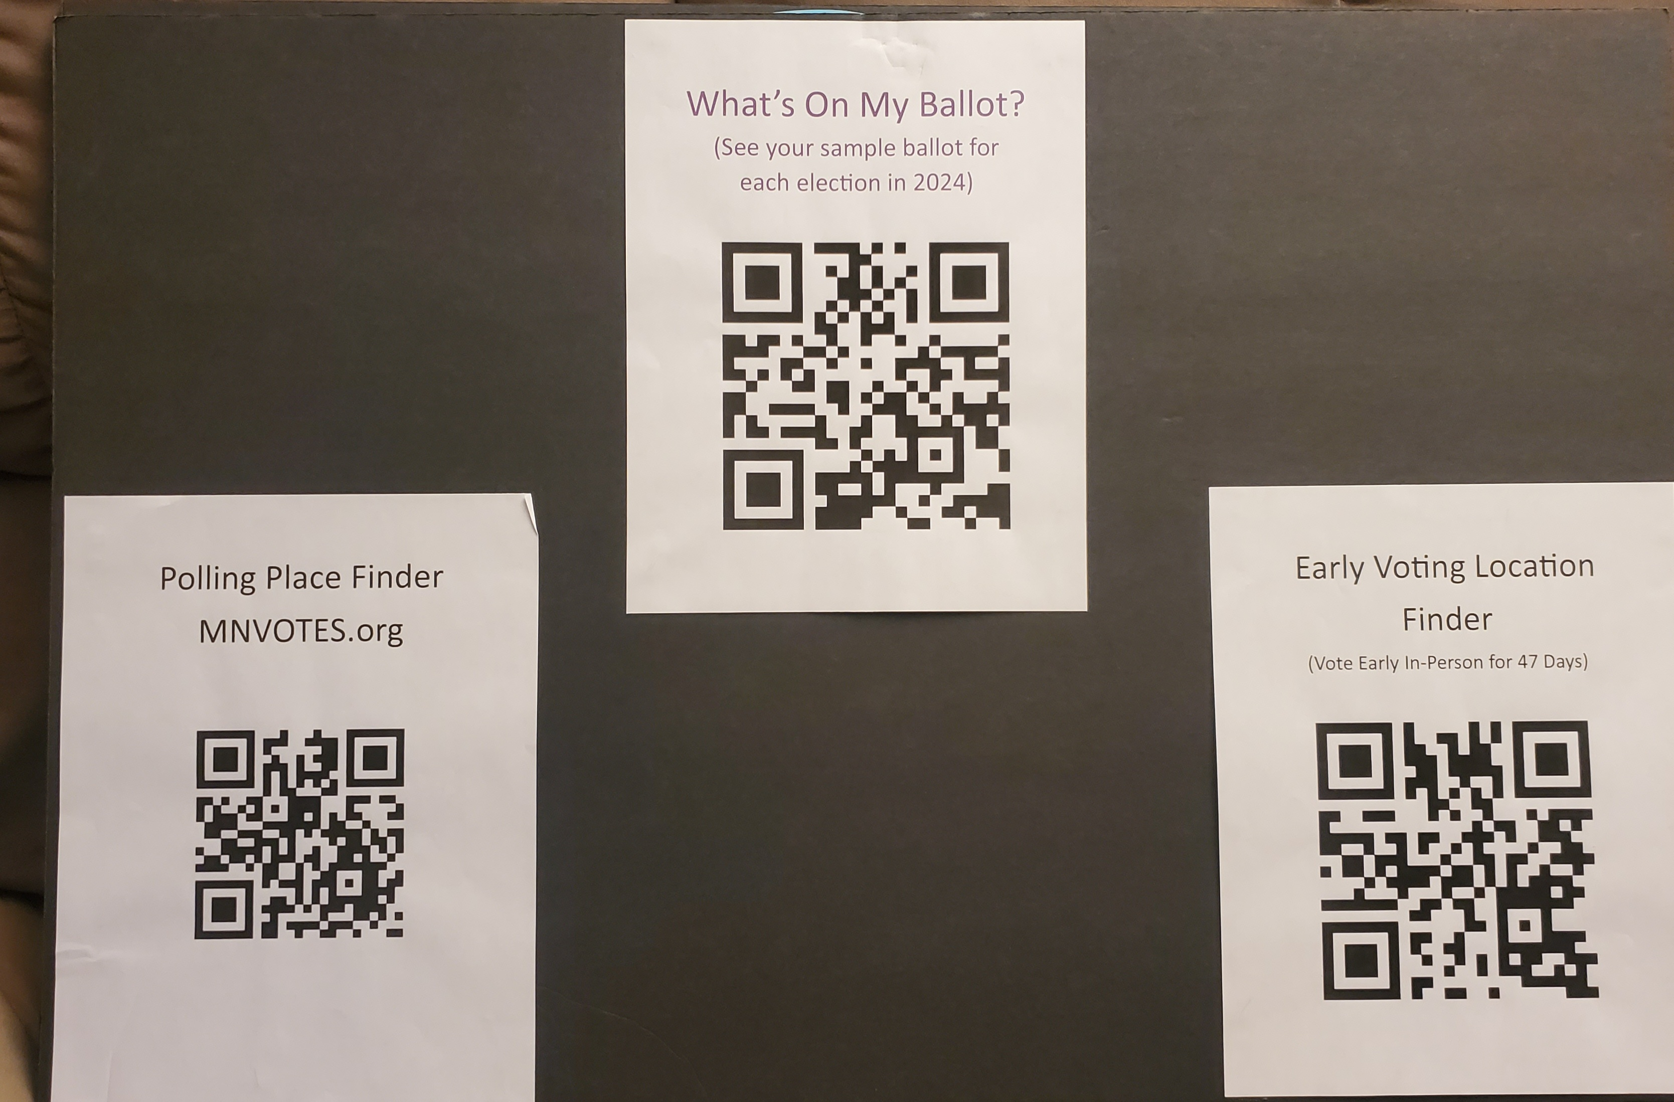
Voter Education at a glance
30 inch x 20 inch foam core board
8” x 11” printed QR codes

Slide 24
47 days
30 inch x 20 inch foam core board
Desk top calendars with highlighted voting days

Slide 25
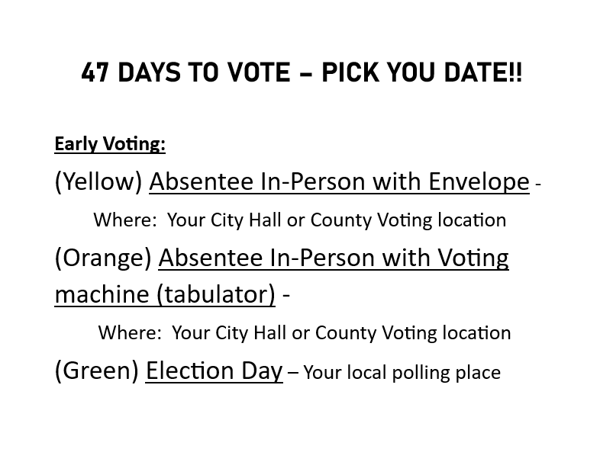
Clear Outline of the new Early voting system.

Slide 26
Republican Caucus Timeline – Possible recruitments and training for Early voter displays?
February 27th Precinct Caucuses
1
?
BPOU Convention
2
April 27
CD2 Convention
3
May 17/18
State Convention
4

Slide 27
Thank you for your time: Brought to you by a Federation of Republican Women local club.
WomenAdvancingFreedom.org

